Slide 1
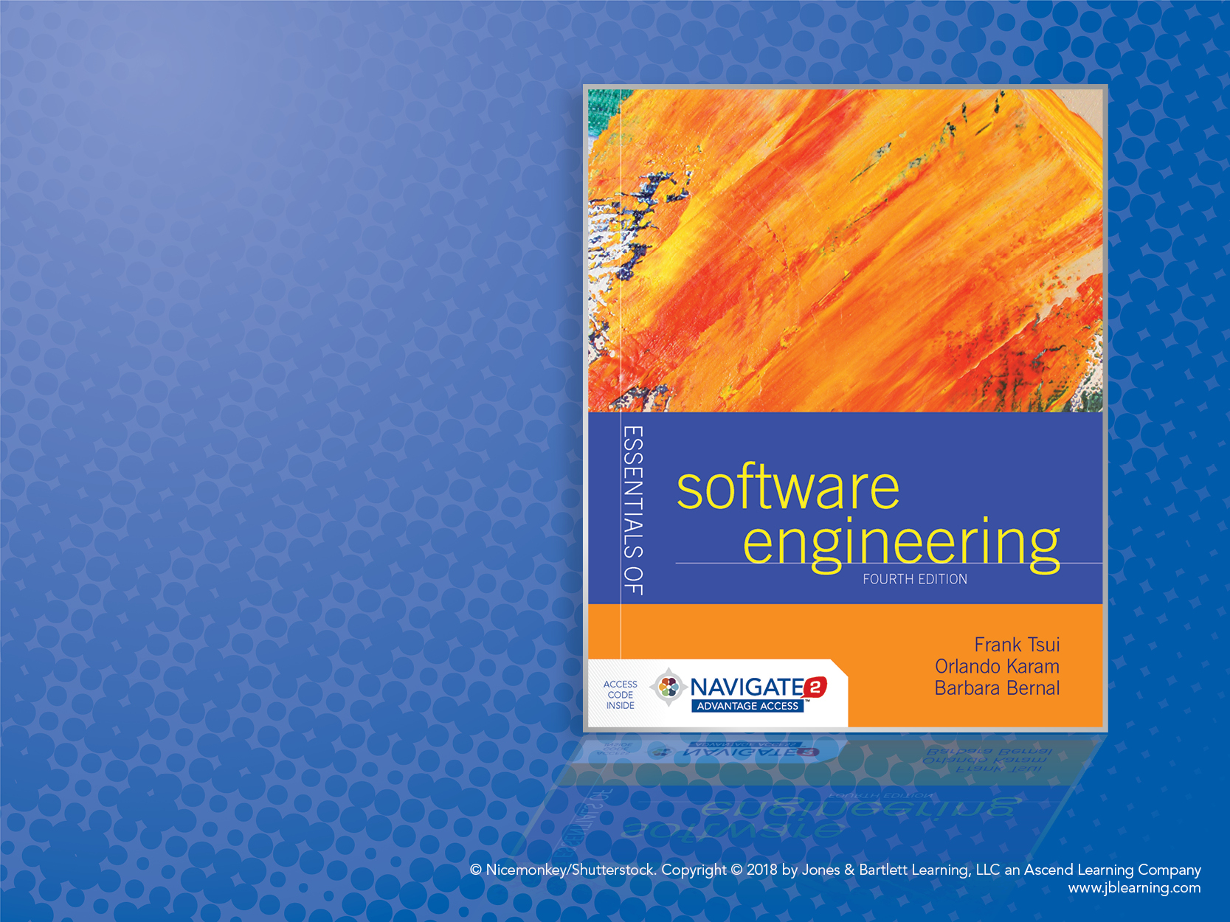
Chapter 1:
Creating a Program

Slide 2
Introduction to Creating a Program
We all “start” by learning how to code in some programming language.
With a small, hypothetical, and fairly well-defined problem.
Usually the code is within one module.
We then learn that the program usually does not work on the first try, second try — may be even 5th or 6th try!
We learn about “testing” the program.
We learn about re-reading and re-thinking the (problem) requirements more carefully — then find that we may not have all the answers.
We learn about tracing and “debugging” the program.
Then — somehow magically — we decide that it’s “good enough !”
Perhaps
Not
in
This
Order
This is a common (popular) developer’s “simple-reflex” approach.

Slide 3
Considerations and Decisions
Problem Statement
“Given a collection of lines of text (strings) stored in a file, sort them in alphabetical order, and write them to another file.”
What Are the Program Requirements?
Input formats? Sorting?
Special cases, boundaries, and error conditions?
Performance? Real time? Security?
What Are the Design Constraints?
User interface? Typical and maximum input sizes?
Platforms? Schedule?

Slide 4
More to Consider and Decide on
Testing Time
While program is defined
While program is developed
After program is completed
Kinds of Tests
Acceptance (validation)
Verification
Unit testing
Black box
White box

Slide 5
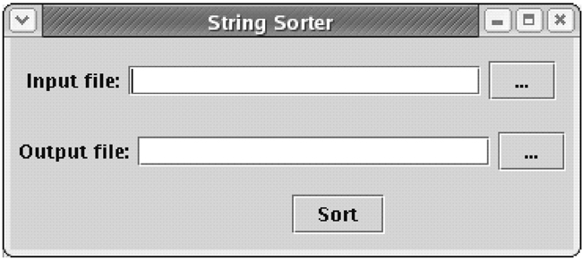
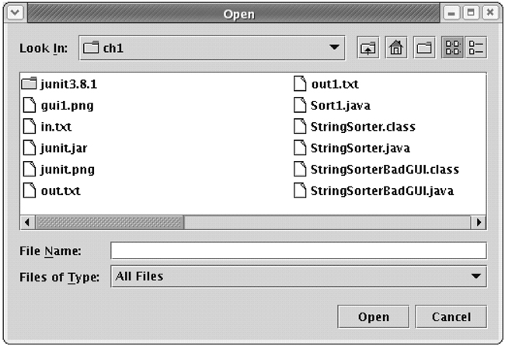
Version 1. Estimate Total Minutes
Write a program that reads lines from one file and writes the sorted lines to another file. Assume that you will be writing the sort routine yourself and will implement a simple GUI (first image).
Pressing one of the two buttons displays a File Open dialog (second image), where the user can navigate the computer’s file system and choose a file.
Assume that you can work only on this one task, with no interruptions. Provide an estimate within 1 minute.
Step 1. Estimated ideal total time: _________________

Slide 6
Version 2. Estimated Calendar Time
Is the assumption that you will be able to work straight through on this task with no interruptions realistic?
Won’t you need to go to the restroom or drink some water?
Can you spend the time needed on this task?
If you were asked to do this task as soon as reasonably possible, starting right now, can you estimate when you would be finished?
Given you start now, estimate when you think you will have this program done to hand over to the client. Also give an estimation of the time you will not be on task (for example: eating, sleeping, other courses, etc.).
Step 2. Estimated calendar time started: ____________ ended:___________ breaks:______________

Slide 7
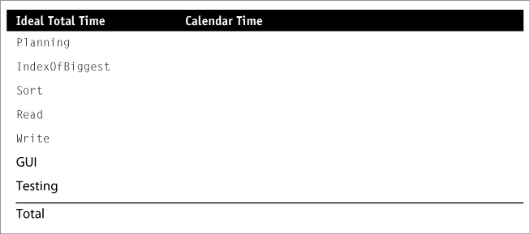
Version 3. Estimation of Subtasks
Divide the entire program into separate developmental tasks; these tasks might be divided into several subtasks.
Your current task is a planning task, which has estimation as a subtask.
When thinking of the requirements for the project, assume you will create a class, called StringSorter, with three public methods: Read, Write, and Sort.
For the sorting routine, assume that your algorithm involves finding the largest element, putting it at the end of the array, and then sorting the rest of the array using the same mechanism. Assume you will create a method called IndexOfBiggest that returns the index of the biggest element on the array.

Slide 8
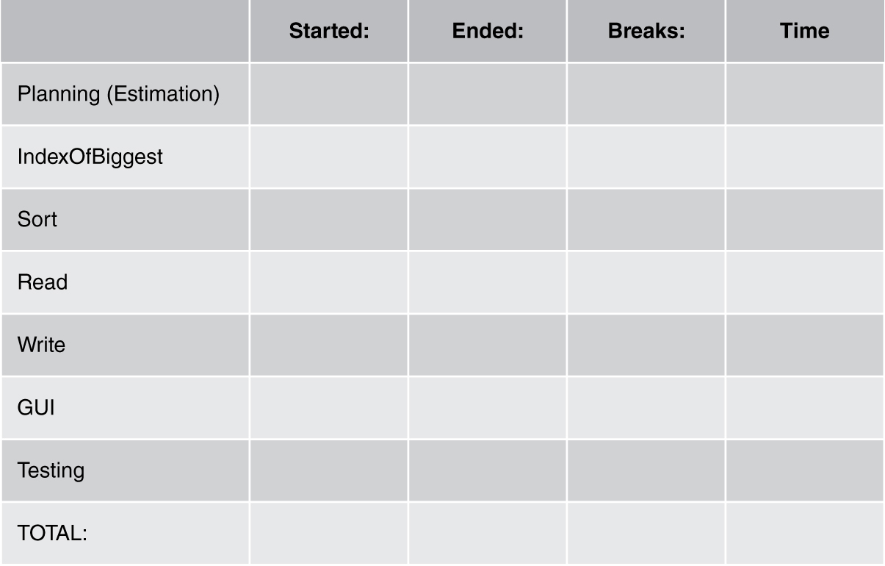
Actual Time Creating the Program
Now design and implement your solution while keeping track of the time.

Slide 9
A “Simple” Set of Steps
1) Understand the problem – requirements
Functionalities
Non-functionalities: performance, security, modifiability, marketability, etc.
2) Perform some design – based on requirements
Organize the functionalities in some sequence; possibly using some diagrams.
Focus on input/output (data, formats, organization).
Think about some constraints (non-functionalities) such as speed, UI looks, programming language, dependencies, etc.
Any specific algorithm and improvements on sequence of functionalities.

Slide 10
A “Simple” Set of Steps (cont.)
3) Code/Implement – turning the design into actual code
Depending on how much design is completed, one may either directly engage in conversion to code (language dependent) or do some more designing.
A) Convert input/output to specific UI interface or I/O format.
B) Sequence the processing in the desired order.
C) Ensure and convert the processing “algorithm” correctly to the target language construct.
D) Figure out how to use language library (properly).

Slide 11
A “Simple” Set of Steps (cont.)
4) Verify/Test the program – check the program results (via output) with some predetermined expected set of inputs.
The pre-determined inputs are “test cases” and require some thinking.
If the results do not match what is expected then:
“Debug”
Fix
Retest — reverify
Stop when all test cases produce the expected results.
Question: How many test cases should we develop and run?

Slide 12
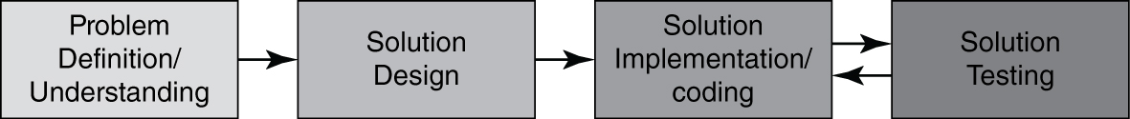
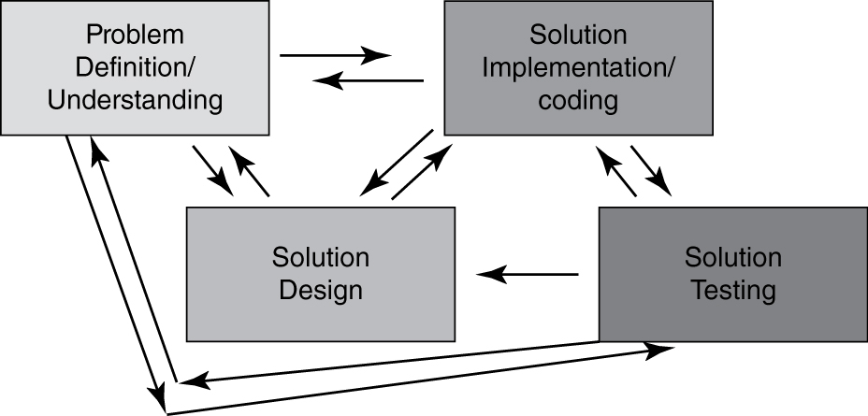
What Really Happens?
“Imagined” – Ideal Situation
“Actual” – Happening

Slide 13
Code Is “Done”! What Else Matters?
How long (elapsed time) did it take to complete the work?
How much effort (total person hours) is expended to do the work?
Does the solution solve the complete problem?
How “good” is the work — (code, design, documentation, testing, etc.)?
based on?

Slide 14
Consider a “Simple” Problem
Write a “program” in your favorite language that will accept numerical numbers as inputs, compute the average, and output the answer.
Answer these questions in class:
How long (in elapsed time) would it take you to implement this solution?
How much overall effort (in person hours) will this take?
How well will your solution match the problem?
How good is your code/design/documentation/testing?

Slide 15
Past Class Answers
How long (in elapsed time) would it take you to implement this solution?
Class Answer: 10 min. (Greg); 15 min. (Frankie); 1 hour (Mark)
How much overall effort (in person hours) will this take?
Class Answer: 10 person min.; 15 person min.; 1 person hour;
3 person hours
Will your solution match the problem?
Class Answer: YES!
How “good” will your solution be?
Class Answer: Awesome!
Let’s see how your “real” individual data come out.

Slide 16
Some “Previous Class” Inputs
How long do you think assignment #1 would take?
1 hr — 7 people
2 hrs — 6 people
3 hrs — 2 people
10 hrs — 3 people
Real data from class:
Elapsed time: range was 5 days to 46 minutes — mostly between 1 to 3 hours.
Effort: range was 8 person hours to 40 person minutes — mostly between 1 person hour to 3 person hours.

Slide 17
Chapter 2: Building a System

Slide 18
Building a “System”
Moving from writing a program to building a system. What’s the difference?!
Complexity, size, Complexity, size ------ Complexity
Breadth of Complexity
Depth of Complexity

Slide 19
Increase of Complexity Everywhere
Solution
Problem
transformation
Increase in
effort due to
size & complexity
Increase in
size & complexity
Increase in
size & complexity

Slide 20
Complexity (Breadth)
More functionalities
More features within each functionality
More varieties of interfaces (internal & external)
More users and varieties of users
More data, varieties of data, data structures
For your assignment 1, what happens if the number of input data increases to 1 trillion and the input numbers themselves are pretty large ?

Slide 21
Complexity (Depth)
More linkages and connections
Data sharing among the functionalities & logic
Control passing among functionalities

Slide 22
Examples for In-Class Discussion
Assignment 1 — compute and show the “average” of the read-in numbers.
“Modified” Assignment 1 — show the largest and the smallest of the read-in numbers.
Where is the complexity increase?
“Further Modified” Assignment 1 — show the read-in numbers in a sorted ascending order.
Where is the complexity increase?

Slide 23
Handling Complexities (A)
Via “simplification”
Decomposition of the problem and of the solution
Modularization of solution
Separation of concerns of problem and of solution
Incrementally resolve problems
*** Not “advertised” but a sometimes used technique is: REDUCE the problem.

Slide 24
Handling Complexities (B)
Via “improving technology and tools”
Database to handle information and structures of information
Programming and dev. platforms
Computing network
Multi-developer configuration management
Modeling techniques of problem and solution
Automated testing
Note: the first time you use these, it will actually be more complex.

Slide 25
Handling Complexities (C)
Via “improving process and methodologies”
Coordinate multiple and different people performing different tasks
Guidance for overlapping incremental tasks
Guidance for measuring separate artifacts and outcomes
Note: first time you put in a process—it is like the new tool—it is more complex.

Slide 26
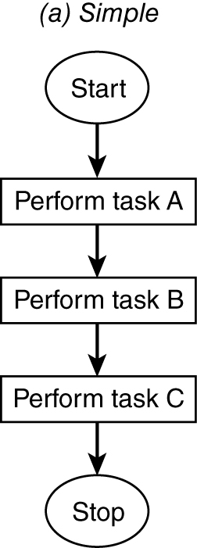
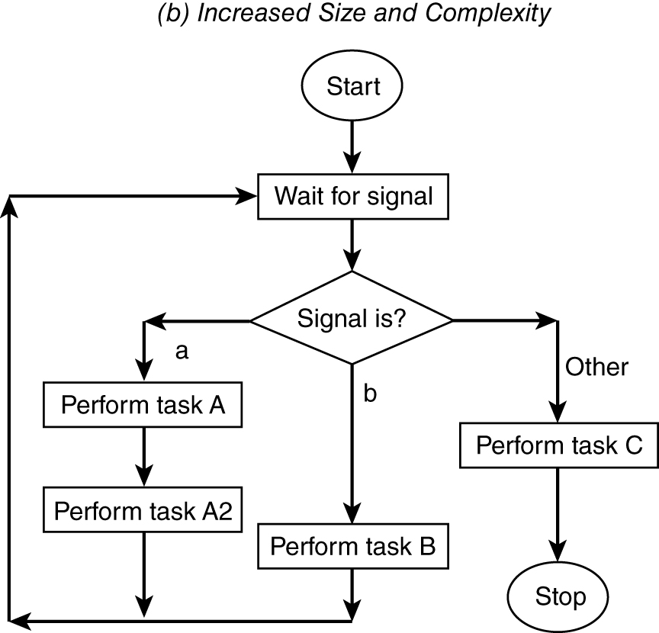
Example of Size and Complexity Increases
(a) Simple
(b) Increased Size and Complexity

Slide 27
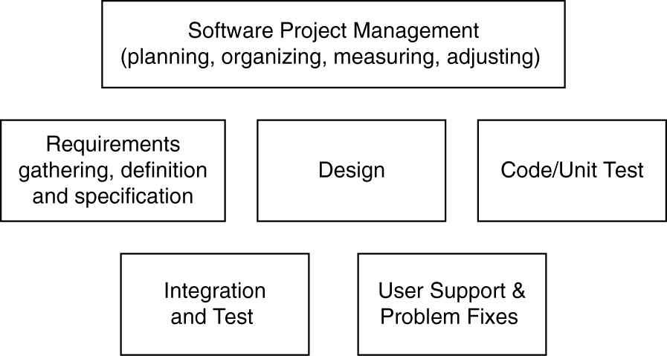
Task Breakdown (Macro) Example (Handling Complexity)
1. Who performs what task?
2. How is the task completed with what technique or tool?
3. When should which task start and end?
4. Who should coordinate the people and the tasks?

Slide 28
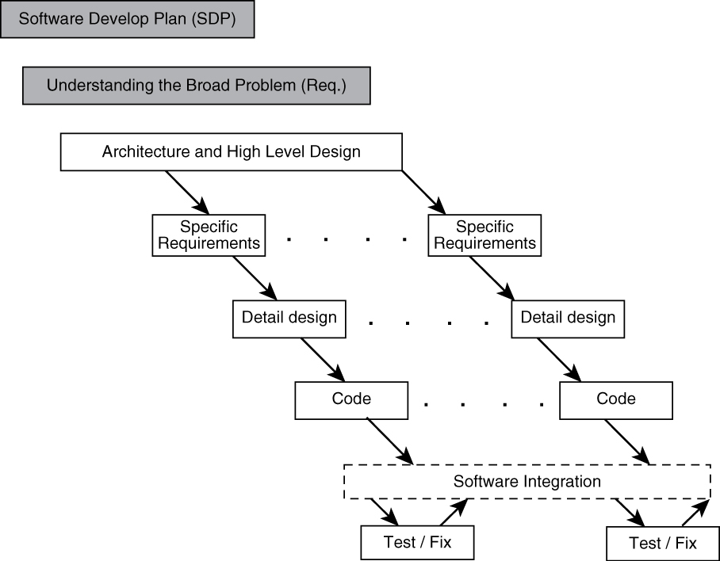
Iterative Process Example (Handling Complexity)

Slide 29
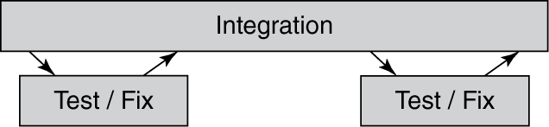
Handling the “Details” Separately
Seemingly “simple” test/fix and integrate steps:
Should there be separate and independent test group?
How should problem be reported and to whom?
How much information must accompany a problem report?
Who decides on the priority of the problem?
How is the problem fix returned?
Should all problems be fixed?
What should we do with non-fixed problem?
How are fixes integrated back to the system?

Slide 30
Some “Non-Technical” Considerations for Developing & Supporting a System (requiring more effort, more resources, etc.)
Effort and Schedule Expansion
How does one estimate and handle this?
Assignment and Communications Expansion?
Do we need some process?
Do we need some tools?

Slide 31
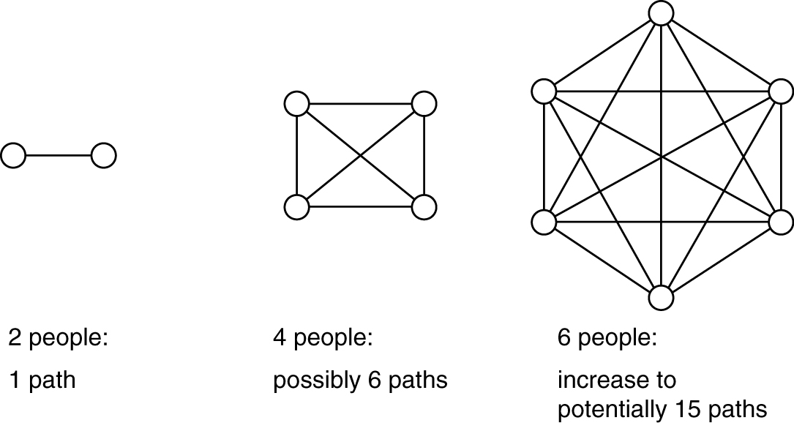
Increase in amount of communications as # of people increases. Also, an increase in the number of communications errors committed.
With the increase in system complexity, there is a corresponding increase in the “manpower” or human resources.
For n people, number of potential communications paths = ∑ (n−1) = [nx(n−1)] / 2

Slide 32
A Large, Complex System
Building “mission-critical” or “business- critical” system (e.g., payroll − in textbook) requires (1) several separate activities performed by (2) more than one person (e.g., 50 ~ 100):
Requirements: gathering, analysis, specification, and agreement
Design: abstraction, decomposition, cohesion, interaction, and coupling analysis
Implementation: coding and unit testing
Integration and tracking of pieces and parts
Separate testing: functional testing, component testing, system testing, and performance testing
Packaging and releasing the system

Slide 33
Also, Need to “Support” the “Payroll” System in Text (for real production) (oftentimes complex systems are not “perfect”)
Pre-release: preparation for education and support:
Number of expected users
Number of “known problems” and expected quality
Amount of user and support personnel training
Number of fix and maintenance cycle
Post-release: preparation for user and customer support:
Call center and problem resolutions
Major problem fixes and code changes
Functional modifications and enhancements

Slide 34
Coordination Efforts Required in Systems Development and Support
Because there are (i) more parts, (ii) more developers, and (iii) more users to consider in “large systems” than a single program developed by a single person for a limited number of users, there is the need for coordination of (3P’s):
“Processes” and methodologies to be used
Final “product” and intermediate artifacts
“People” (developers, support personnel, and users)
The previous diagram on people increase and potential communication paths
increase provides a clue to the importance of coordination efforts.

Slide 35
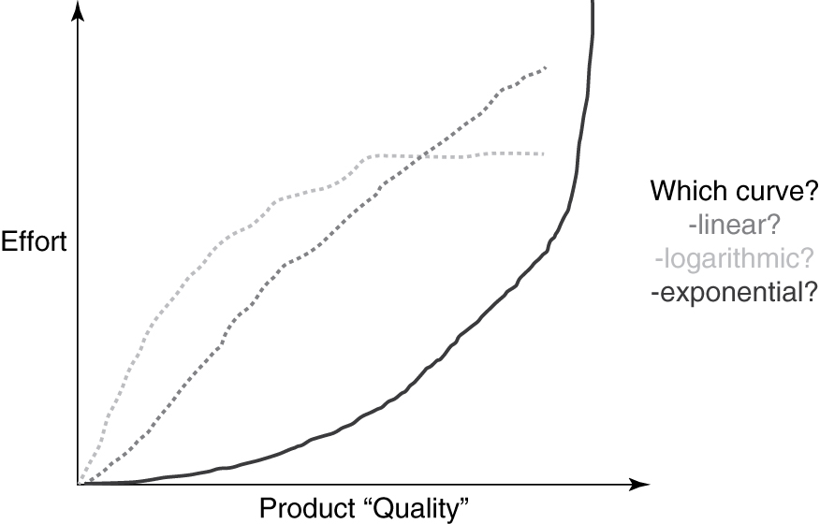
Effort vs. Software Product “Quality”

Slide 36
Complexity vs. Software Product Quality? Complexity vs. Software Dev. Effort? What type of “relationship” can we expect?
Complexity
Complexity
?
?
Software Product Quality
Software Development Effort

Slide 37
Chapter 3: Engineering Software

Slide 38
Engineering Software
As size and complexity of software projects increased, so did the number of failed projects.
“Engineering” software was thought to be the cure:
Put some discipline into “programming.”
Do more than just coding/programming.
“Study” (model/measure), “Understand” (analyze), and “Improve” (change) this field!

Slide 39
Chaos Report and Software Project Success/Failures
Chaos Report (1995) sampled some 300 software projects and reported that only about 16% of those projects “completed,” “on time,” and “within budget”!
That is 84% of projects failed!
Chaos Report (2009) stated that software projects have improved with 32% “completed,” “on time,” and “within budget.”
That is still 68% of projects—failure!

Slide 40
Chaos 2014 Report
39% successful software projects
43% challenged software projects
(late, over budget, or less functionality)
18% failed software projects
(cancelled or never used)
This means we still have 61% project failures.

Slide 41
Software Project Success & Failure Factors (Chaos Report)
Profiling attributes for projects that “succeeded”
User involvement
Executive management support
Clear requirements
Proper planning
Profiling attributes for “challenged” (completed & operational – but over budget and over time estimate)
Lack of user input
Incomplete user requirements and specification
Changing requirements and specifications
Profiling attributes for “impaired and ultimately cancelled”
Incomplete requirements
Lack of user involvement
Lack of resources

Slide 42
Software Product Failures (Capers Jones Study)
Code errors : 38.33%
Design errors : 24.17%
Documentation errors : 13.33%
Requirements errors : 12.50%
Bad-fix errors : 11.67%
All errors can be serious and very costly but
Should we worry about coding more or requirements more – Why?
Requirements errors are very “costly” if not detected & left in the product – Why?

Slide 43
Coordination & Non-Technical Concerns
As software projects grew in size and complexity, problems went beyond just code and software. Other “non-technical” issues became apparent:
Executive commitment and leadership
Thorough planning of both business and technical processes
Skilled and experienced work force
Management focus and project monitoring
Willingness to make changes and adjustments

Slide 44
US General Accounting Office Report to US Senate (2004)
3 “key” strategies to ensuring delivery of:
(a) High-quality software
(b) On time and
(c) Within budget
Focused attention on software development environment (people/tools/management/etc.)
“Disciplined” development process
Methodical use of metrics to gauge cost, schedule, and functional performance targets

Slide 45
“Birth” of Software Engineering
The early experiences of writing difficult but “small programs” did NOT provide us with the road map when we started to build “large” operating system, database, commercial system, etc.
What is needed to develop large and complex software “products” and what is needed to control such projects?
More “discipline” is needed in this field.
“SOFTWARE ENGINEERING!!!”
(NATO conference – 1968)

Slide 46
What Is Software Engineering?
David Parnas – multi-person construction of multi-version software.
Sommerville – “an engineering discipline whose focus is the cost-effective development of high-quality software system.”
Pfleeger – application of computing tools to solving problems.
CMU/SEI-90-TR-003 – “form of engineering that applies the principles of computer science and mathematics to achieving cost-effective solutions to software problems.
IEEE std 610-1990 – “application of a systematic, disciplined, quantifiable approach to the i) development of, ii) operation of, and iii) maintenance of software.”
What
are
these?
Curriculum Guideline: “creating high quality software in a systematic,
controlled, and efficient manner.”

Slide 47
Software Engineering (Tsui and Karam)
Software engineering is a broad field that touches upon all aspects of (a) developing and (b) supporting a software system, spanning across the following key areas:
1. Technical and business processes
2. Specific methodologies and techniques
3. Product characterization and metrics for measurements
4. People skills and team work
5. Project coordination and management

Slide 48
Relevancy of Software Engineering
Software is a serious business.
Reached $180 billion in 2000.
It is ubiquitous across multiple industries.
Software is a commodity of increasing “value.”
The business of software has graduated from a “garage” operation to an “enterprise” profession — including recent “Facebook.”
We need to treat software engineering as an engineering profession.
15 universities have received accreditation (2009) from accreditation board of engineering and technology.

Slide 49
Software Engineering “Professionals”
There is no equivalent “professional engineer” (PE) designation for software engineers, yet.
Except in Texas where the board of professional engineers adopted software engineering as a specific discipline under which an engineering license may be issued.

Slide 50
Updated Information
Software industry in 2013 is $407 billion business (Gartner report).
We now (2014) have 22 US universities (including SPSU) with accredited software engineering programs (ABET report).

Slide 51
So — how do we become more “professional” in Software Engineering? Any more guidance?

Slide 52
IEEE-CS/ACM Version 5.2 Report
8 principles** for ethics and professional practices in software engineering
Software engineers shall act consistently with the public interest.
Software engineers shall act in a manner that is in the best interest of their client and employer, consistent with the public interest.
Software engineers shall ensure that their products and related modifications meet the highest professional standards possible.
Software engineers shall maintain integrity and independence in their professional judgment.
Software engineering managers and leaders shall subscribe to and promote an ethical approach to the management of software development and maintenance.
Software engineers shall advance the integrity and reputation of the profession consistent with the public interest.
Software engineers shall be fair to and supportive of their colleagues.
Software engineers shall participate in lifelong learning regarding the practice of their profession and shall promote an ethical approach to the practice of the profession.
** Under each of these major principles, there are further sub-principles.

Slide 53
A “Simpler” Set of Behavioral Rules
Respect others.
Strive for fairness.
Perform to one’s best capability.
Follow the law.

Slide 54
“General Principles”
Different from other engineering disciplines such as civil or mechanical, there is no one set of “universal principles” in software engineering that is agreed upon by everyone. Neither is there any “law” of software engineering such as Newton’s law of motion in physics.
There are, however, several that are well received and respected.
Davis’s Principles
Royce’s Principles
Wasserman’s Concepts

Slide 55
Davis’s Early 15 Principles
Make quality number 1.
High-quality software is possible.
Give products to customers early.
Determine the problem before writing the requirements.
Evaluate design alternatives.
Use an appropriate process model.
Use different languages for different phases.
Minimize intellectual distances.
Put techniques before tools.
Get it right before you make it faster.
Inspect code.
Good management is more important than good technology.
People are the key to success.
Follow with care.
Take responsibility.
Are these consistent within themselves?
How “key” is “people are key to success”?
What do you think?

Slide 56
Royce’s More “Modern” Set of Principles
Base the process on an architecture first approach.
Establish iterative process – address risk early.
Emphasize component-based development to reduce effort.
Establish change management.
Use round-trip engineering – a form of iterative process.
Use model-based and machine-processable notations for design.
Establish process for quality control and project assessment.
Use approach that allows artifacts to be demonstrated early.
Plan to have incremental releases.
Establish a configurable process to suit the needs.
How many deal with
“process” / “technique”?
Agree with these? Why ?

Slide 57
Wasserman’s Fundamental Concepts
Abstraction (a form of simplification)
Analysis and design methods and notation
User interface prototyping
Modularity and architecture
Reuse
Life cycle and process
Metrics
Tools and integrated environment
How many deal with
“process” / “technique”?
“Important concepts” — how do they relate to the earlier
listed principles from Davis or Royce?

Slide 58
These “Principles” Address the Earlier Mentioned
3 “key” strategies to ensuring delivery of:
(a) High-quality software
(b) On time and
(c) Within budget
Focused attention on software development environment (people/tools/management/etc.)
“Disciplined” development processes
Methodical use of metrics to gauge cost, schedule, and functional performance targets

Slide 59
Chapter 4: Software Process Models

Slide 60
What Is a Process Model?
It is a description of
i) what tasks need to be performed in
ii) what sequence under
iii) what conditions by
iv) whom to
achieve the “desired results.”

Slide 61
Why Have a Process Model?
Provide “guidance” for a systematic coordination and controlling of
a) the tasks and
b) the personnel who perform the tasks
Note the key words: coordination/control, tasks, people.

Slide 62
Do we need a process if the project requires just one person or at most two people?
Why? ---- Why not ?

Slide 63
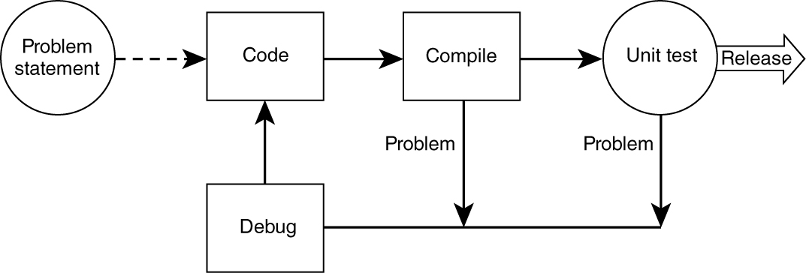
A “Simple and Familiar” Process
1. Most people perform and follow this simple process, but unfortunately some skip unit testing or debugging.
2. Also, some proceed without thoroughly considering & understanding the “problem statement”—which is the requirement.

Slide 64
Extending the “Simple” Process
As projects got larger and more complex:
Needed to clarify and stabilize the requirements
Needed to test more functionalities
Needed to design more carefully
Needed to use more existing software and tools
Database
Network
Code control
Needed more people to be involved
Resulting in more tasks and more people

Slide 65
With More People and More Tasks
We now need to “define”:
the set of tasks that need to be performed
the sequence of flow of the tasks
the input and the output from these tasks
the pre-condition and post-conditions for each task
The people and skills needed to perform the tasks

Slide 66
Some “Traditional” Software Development Processes
The earlier “simple” process was employed by many for years without formally embracing other important development activities such as requirements analysis, design, formal testing, or packaging.
The recognition of the need for formal processes was initially driven by failures in developing large complex software.
Waterfall: earliest process and coping with no process
Incremental: coping with decomposing the large systems
Spiral: coping with risk management
Rational Unified Process: coping with multiple development and management issues

Slide 67
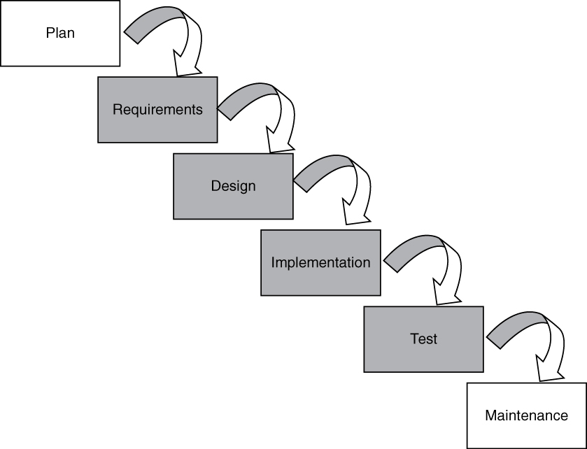
Waterfall Model
1. Requirements must be specified.
2. Four main tasks must be completed in sequence: requirements, design, code, and test, followed by integration.
3. Output of one stage feeds into the next stage in sequence, and thus is easily tracked (“controlled”) by management.

Slide 68
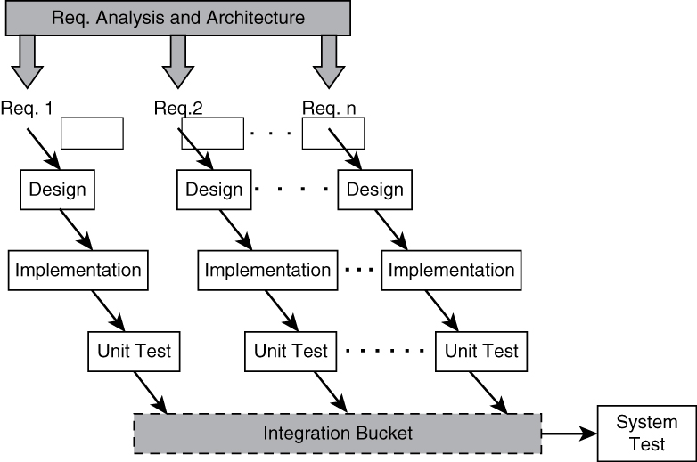
Incremental Model (A) – “Continuous Integration”
Each “major requirement/item” is developed separately through the same sequence of: requirement, design, code, and unit test.
2. As the developed pieces are completed, they are continuously merged and integrated into a common bucket for integrated system test.

Slide 69
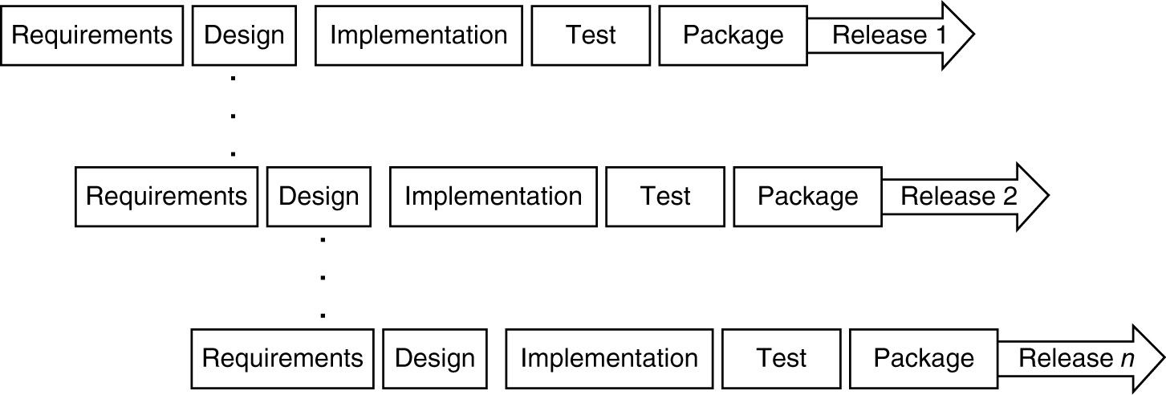
Incremental Model (B) – “Multiple Releases”
Each small set of requirements is developed,
packaged, and released in a multiple release
fashion.

Slide 70
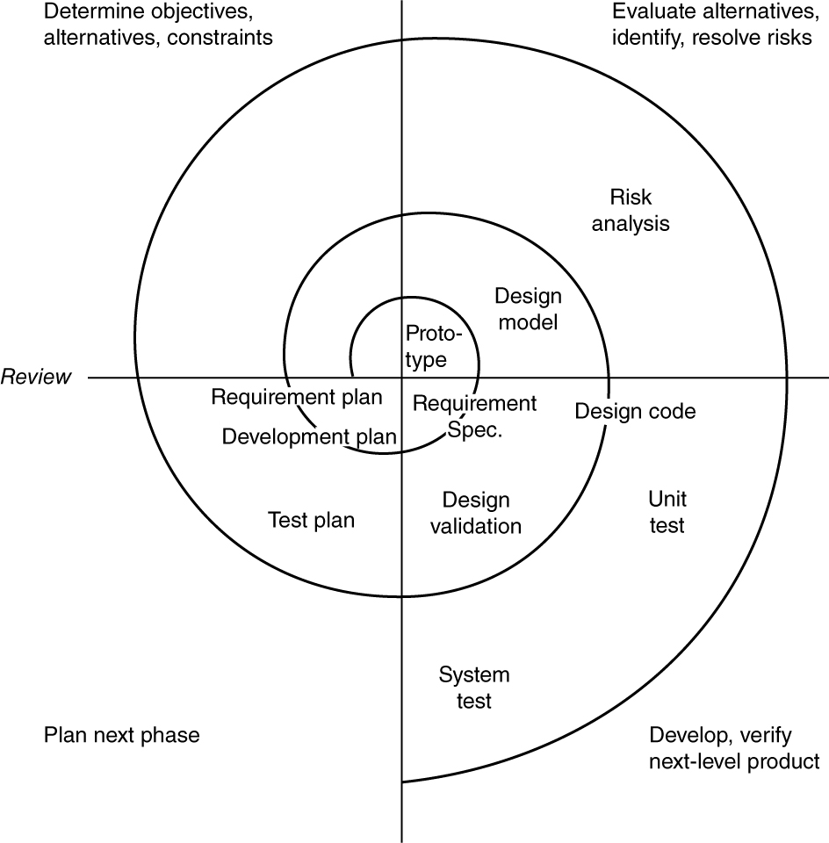
Spiral Model
<INSERT FIGURE 4.5>
– Software development activities are cycled through four phases.
– A “risk-averse” process first proposed by Barry Boehm.

Slide 71
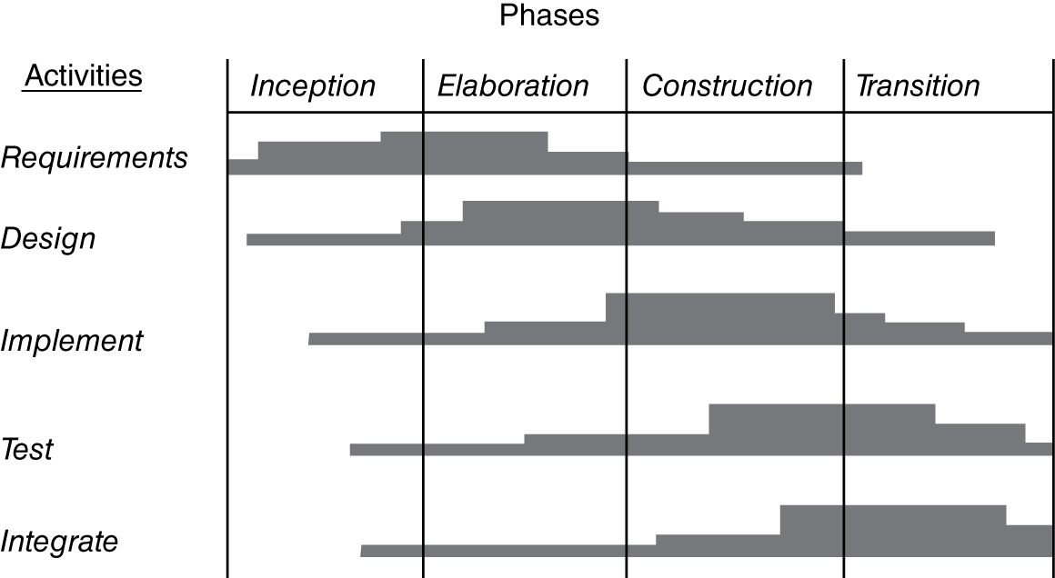
Rational Unified Process (RUP)
Every software development
activity is “addressed” in the four phases of inception, elaboration, construction, and transition.

Slide 72
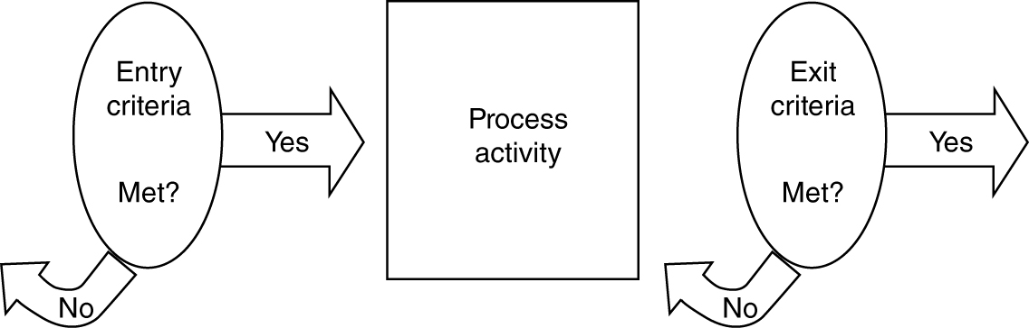
Entry and Exit Criteria
In order for a process model to be more than just
a “guideline,” it must include a list of conditions or
requirements that define the:
– entry criteria prior to performing an activity in a process.
– exit criteria before an activity in the process is deemed completed.

Slide 73
Assessment of Software Organizations
Software development and software support may be done with very little process or with very sophisticated, well-defined, well-organized, and well-executed processes.
How mature is your software engineering organization and do you need to improve?
ISO (ISO 9000 series) and SEI (Software Engineering Institute at Carnegie Mellon) are two leading organizations that help in the process assessment.
No Process
Matured Process
Where are you in
this wide spectrum?

Slide 74
SEI’s Original CMM – Early 1990s
Software Engineering Institute (SEI) proposed a Capability Maturity Model (CMM) to help software organizations assess their maturity and provide guidance in software development.
Initial: there is no process and any success is by luck or with a special person.
Repeatable: has mastered 6 processes and can repeat its success with these 6 processes: 1) requirements management, 2) project tracking, 3) quality assurance, 4) project planning, 5) subcontract management, and 6) configuration management.
Defined: has mastered 7 more processes and is competent at software construction: 1) organization process, 2) training program, 3) product engineering, 4) peer review, 5) organization process definition, 6) integrated software management, and 7) inter-group coordination.
Managed: has introduced 2 more processes that deal with quantitative measurement and quality: 1) quantitative process management and 2) quality management.
Optimizing: reaching this highest level requires the mastering of continuous improvement with 3 more processes: 1) defect prevention, 2) technology change management, 3) process change management.

Slide 75
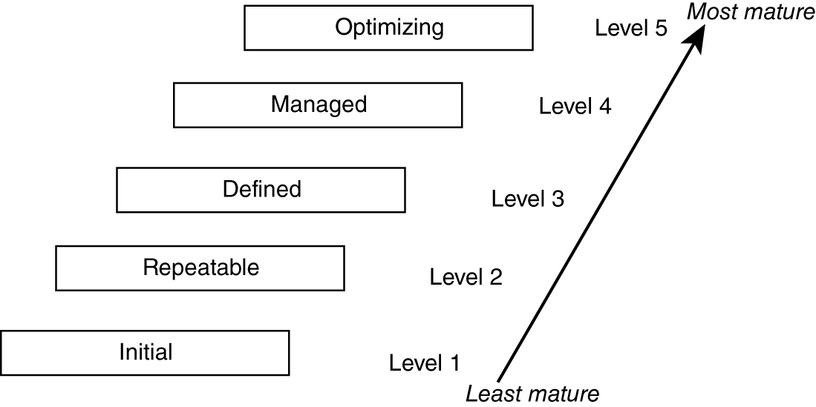
SEI’s Five Levels of Original “Capability Maturity Model” (CMM)
Total of 18 processes need to be mastered to achieve “optimized” level.
See page 77−78 of your text for the 18 “key” processes.

Slide 76
SEI’s CMMI
In 2001, CMM was upgraded to CMMI (CMM Integrated). Started with multiple, major aspects to CMMI:
Systems engineering
Software engineering
Integrated product and process development
Supplier sourcing

Slide 77
Two Representations of CMMI
The software engineering portion of CMMI has two representations:
Staged: similar to the CMM assessment of organization
Continuous: better for assessing maturity of each process

Slide 78
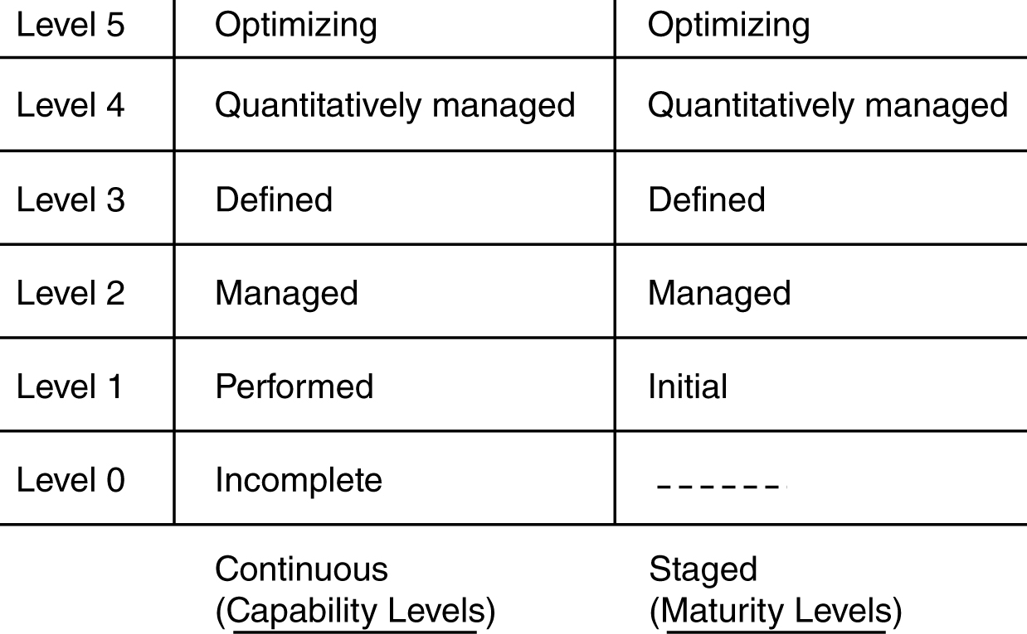
Levels for Continuous versus Staged Models in CMMI

Slide 79
25 Processes of CMMI
There are 25 processes covering 4 major categories:
Process Management (has 5 processes):
Organization process focus
Organizational process definition
Organizational training
Organizational process performance
Organizational innovation and deployment
Project Management (has 8 processes):
Project planning
Project monitoring and control
Supplier agreement management
Integrated project management
Risk management
Integrated teaming
Integrated supplier management
Quantitative project management

Slide 80
25 Processes of CMMI (cont.)
Engineering (has 6 processes)
Requirements development
Requirements management
Technical solution
Product integration
Verification
Validation
Support (has 6 processes)
Configuration management
Process and product quality assurance
Measurement and analysis
Organizational environment for integration
Decision analysis and resolution
Causal analysis and resolution

Slide 81
Continuous versus Staged Models
In Continuous Representation, each process starts at capability level 0 and moves up the capability levels based on achieving “generic goals” and “specific sub-goals.”
Allows the organization to choose and pick the process to focus on based on the needs of the organization.
Allows comparison of process area by process area between organizations.
Allows easier migration from other standards.
In Staged Representation, the organization starts at maturity level 1 and moves up the levels based on mastering sets of processes.
Allows easy migration from the earlier CMM model.
Provides a guidance of sequence of maturity by process areas.
Allows easier comparison of organizations by maturity levels.

Slide 82
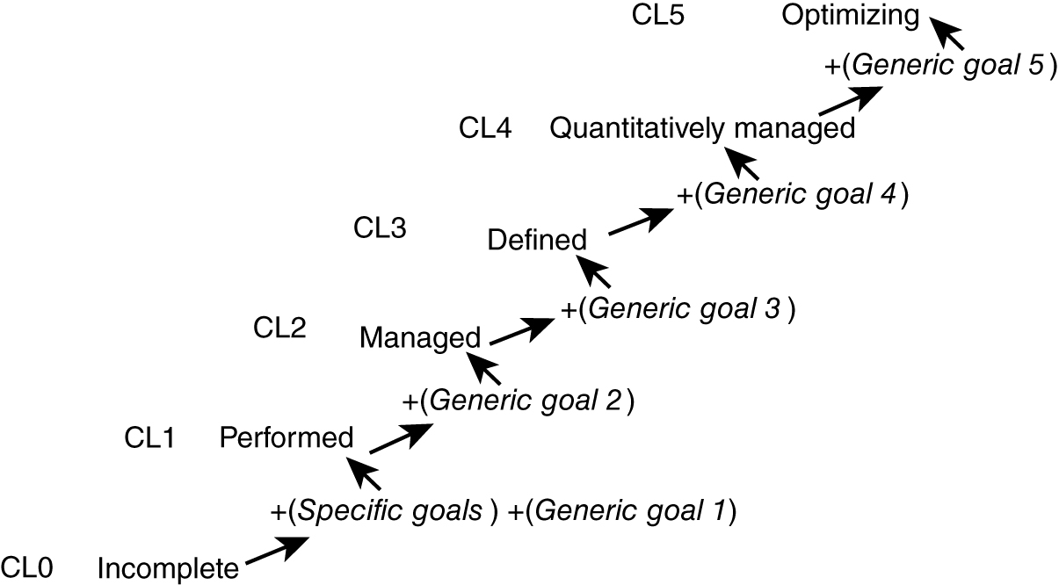
Achieving the “Capability Levels” by Each Process Area in the Continuous Representation Model

Slide 83
Five Generic Goals
Goal 1 – Achieve all the specific goals of the specific process.
Goal 2 – Institutionalize the managing of consistency of that process across organization.
Goal 3 – Institutionalize the defining of that process across the organization.
Goal 4 – Institutionalize quantitatively managing that process across the organization.
Goal 5 – Institutionalize continuous optimizing/improving that process across the organization.

Slide 84
Achieving “Maturity Level” (ML) in the Staged Representation model
ML1 (0 process): no process
ML2 (7 processes): 1) requirements management, 2) project planning, 3) project monitoring, 4) supplier agreement management, 5) measurement and analysis, 6) process and product quality assurance, 7) configuration management
ML3 (14 processes): 1) requirements development, 2) technical solution, 3) product integration, 4) verification, 5) validation, 6) organizational process focus, 7) organizational process definition, 8) organizational training, 9) integrated project management, 10) risk management, 11) integrated teaming, 12) integrated supplier management, 13) decision analysis and resolution, 14) organizational environment for integration
ML4 (2 processes): 1) organizational process performance, 2) quantitative project management
ML5 (2 processes): 1) organizational innovation and deployment, 2) causal analysis and resolution

Slide 85
Process Definition & Communication
Two Main Components of Process Definition:
Major activities
Sequencing of activities
*Most of the organizations need to modify an existing process to better fit their needs — thus they must define in more detail and communicate the modified process definitions (a major endeavor).*
Expanding process definition to more “refined” level:
Detailed description of the activities
Control needed for entrance and exit of each activity and the ordering of the activities
Artifacts that result from the activities
Human resources required to perform the activities
Tools that may be needed to aid the performance of the activities

Slide 86
Chapter 5: New and Emerging Process Methodologies

Slide 87
Problems with “Traditional” Processes
Focused on and oriented towards “large projects” and lengthy development time (years) — started SWE.
Inability to cope with changes in requirements and technology fast enough — “formal” change mgmt.
Assumes requirements are completely understood at beginning of project — stable requirements.
Starting to rely on “non-sustainable” heroic and lengthy development effort by the developers — hard to maintain “constantly high” productivity.
Complex set of activities — needed process experts.
Waste or duplication of effort, especially in documentation — formal documentation needed for long and large project communications.

Slide 88
More Recent Processes: Agile Methodologies
Family of software development methodologies:
“Short” releases and multiple iterations
Incremental design/development
User involvement (especially for in-house)
Minimal documentation
Informal communications
Assumes changes

Slide 89
The Agile Manifesto
“We are uncovering better ways of developing software by doing it and helping others do it.
That is, while there is value in the items on the “right,” we value the items on the “left” more.”
“left” “right”
1. Individuals and interactions - - over processes and tools 2. Working software - - over comprehensive documentation 3. Customer collaboration - - over contract negotiation 4. Responding to change - - over following a plan — “dogmatically”
http://www.agilemanifesto.org

Slide 90
Some Agile Methodologies
Extreme Programming (XP) – the first by Beck (1990s)
Crystal Clear/Orange – by Alister Cockburn
Scrum – currently popular
(not really part of Agile – partially agile)
RUP (rational unified process)
Microsoft Solutions Framework (tool/process)

Slide 91
XP’s Core Values
Communication (between team and with customers)
Simplicity (in design and code)
Feedback (at many levels)
Courage (to make and implement difficult decision)

Slide 92
XP’s Fundamental Principles
Rapid feedback
Simplicity
Incremental change
Embrace change
Quality work
Directly from “core” values

Slide 93
XP’s Lesser/Other Principles
Ongoing learning
Small initial investment
Playing to win
Concrete experiments
Open, honest communications
Working with people’s instincts
Accepting responsibility
Local adaptation
Traveling light
Honest measurement

Slide 94
XP’s 12 Key Practices
Based on the concept of quick and constant “feedback mechanism” involving:
Planning Game (small units of requirements)
Onsite Customer (immediate and better feedback)
Metaphor (use one set of metaphor for design/architecture)
Simple Design (just enough to cover what’s needed)
Coding Standard (facilitates better communication)
Collective Code Ownership (peer pressure to improve code)
Pair Programming (feedback and shared improvements)
Refactoring (continuous examination for duplicative design/code)
Continuous Functional and Unit Testing (100% completion)
Small/Short Releases
Continuous Integration (integrating of small releases)
40 Hour Work (high morale and energy level)
some
recognition
of
“human”
aspects

Slide 95
Extreme Programming “Process”
Onsite Customers
Coding Standards
Simple Design
Planning
Game
Pair Programming
Functional &Unit Test
Small/Short
Release
System Metaphors
Continuous Integration
Refactoring
Collective Code
Ownership
Larger
Release
Adhere to 40 hour work week as much as possible! -- sustainable pace

Slide 96
Crystal Family of Methodologies
Cockburn classified projects via:
Size (by number of developers involved)
Criticality (by losses a malfunction or defect will cause – “quality”)
Priority (time pressure on the project)
Alistair Cockburn introduced a family of three methodologies
Crystal Clear for “non-critical” projects (6–8 people)
Crystal Orange for “critical” projects (up to 40 people)
Crystal Orange Web for web development

Slide 97
Scrum Development Process (Currently Popular)
First introduced by Takeuchi and Nonaka (Japan) in 1986 modeled after the way rugby game is played.
Ken Schwaber and Mike Beedle published a book, “Agile Software Development with Scrum,” in 2001.
It is an incremental and iterative development approach:
Develops small “sprints,” or increments (of features) in a short cycle of about 2–3 weeks.
There are three main roles.
Product Owner who talks to and decides with users about the content of each sprint
Scrum Master who runs the sprints
Scrum Team of about 7–8 members who develop the sprint

Slide 98
Chapter 6: Requirements Engineering

Slide 99
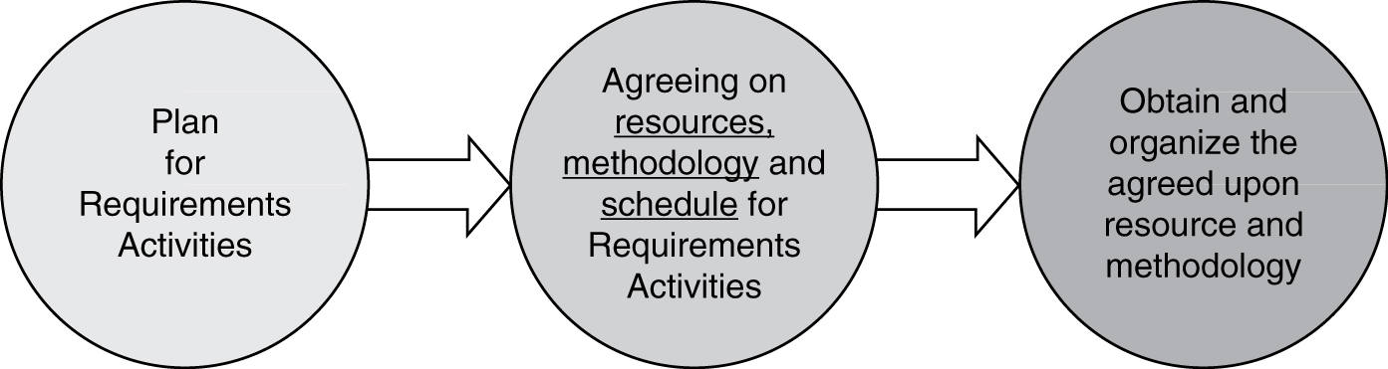
Preparation for Requirements Engineering
1. Prior to actually performing the requirements engineering activities, it is important to plan for the resources, methodology, and time needed to perform this crucial step in software engineering.
2. Some organizations even perform requirements engineering as a separate, stand-alone activity and price it separately, with the option of folding the cost into the whole project if they get the call to complete the software project.

Slide 100
Major Requirements Engineering Activities
Elicitation
Documentation and definitions
Prototyping
Analysis
Specification(s)
Review and validations
Gain agreement and acceptance
Note: This list does not address “inventing” new requirements.

Slide 101
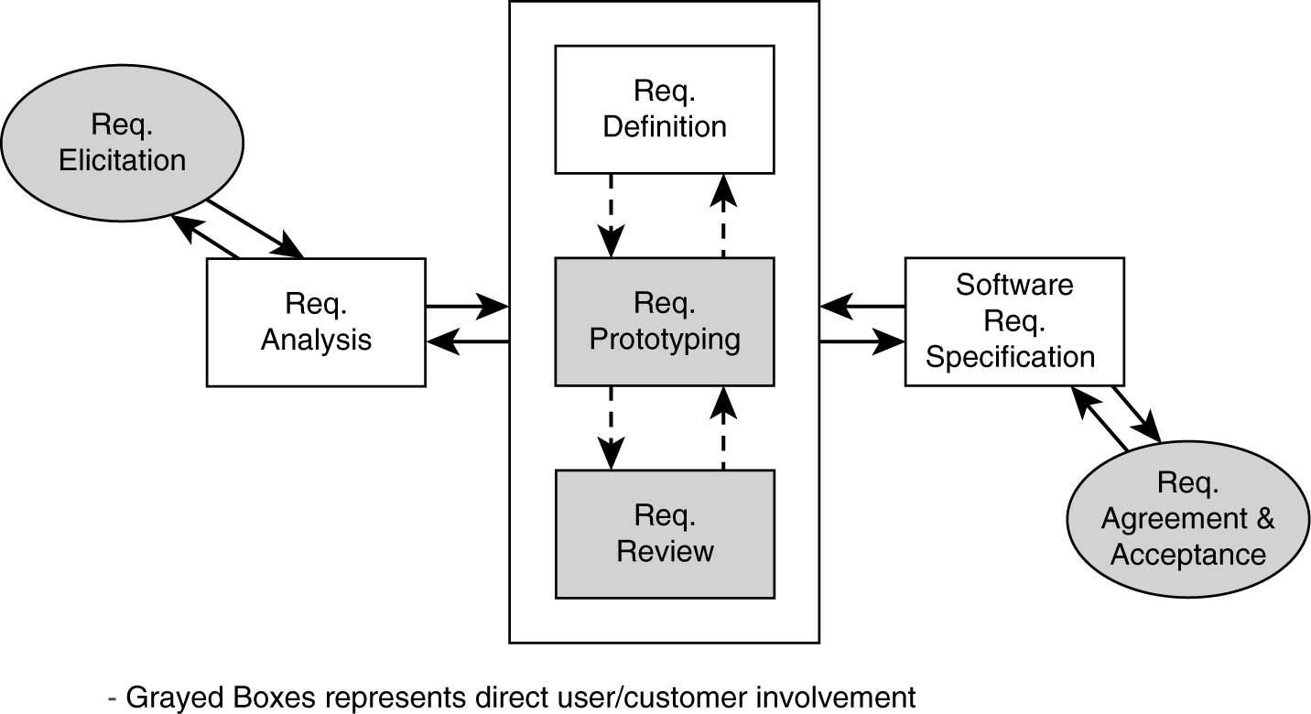
Requirements Engineering Activities

Slide 102
Why Is This Set of Activities Important and Why Should Requirements Be Documented? (Remember Chaos Report?)
Clear requirements are needed for design and implementation activities.
Requirements documentation is needed to create test cases and test scenarios—especially for large systems where the test team is a separate group of people from the developers.
Requirements document is needed to control potential scope-creep.
Requirements document is needed to create user training material, marketing material, and documents for support and maintenance.
Requirements document provides a way to segment a large project, prioritize releases, and simplify project management.
Think about agile processes where this crucial step may sometimes be
“compromised” by the novice software engineers.

Slide 103
Requirements Elicitation
Requirements:
May be given to the software engineers.
Initial product/system requirements
For second and/or third follow-on release of a “planned” sequence of software product where a preliminary set of requirements are already established
Requirements provided as part of a request for price quotation for a software development project
Have to be established by software engineers.
Users sometimes have an understanding of only the requirements related to their specific job tasks.
The business rationale and goals are not always clear to individual user and needs to be established for prioritization reason.
There may be contradicting and incomplete requirements stated by the users and customers.

Slide 104
High-Level Requirements Elicitation
Need to seek out the business and management perceptions and goals for the software project.
Business opportunity and business needs
Justification for the project
Scope
Major constraints
Major functionality
Success factor
User characteristics
Software engineers who have to interact with business management
and handle requirements are sometimes called business analysts.

Slide 105
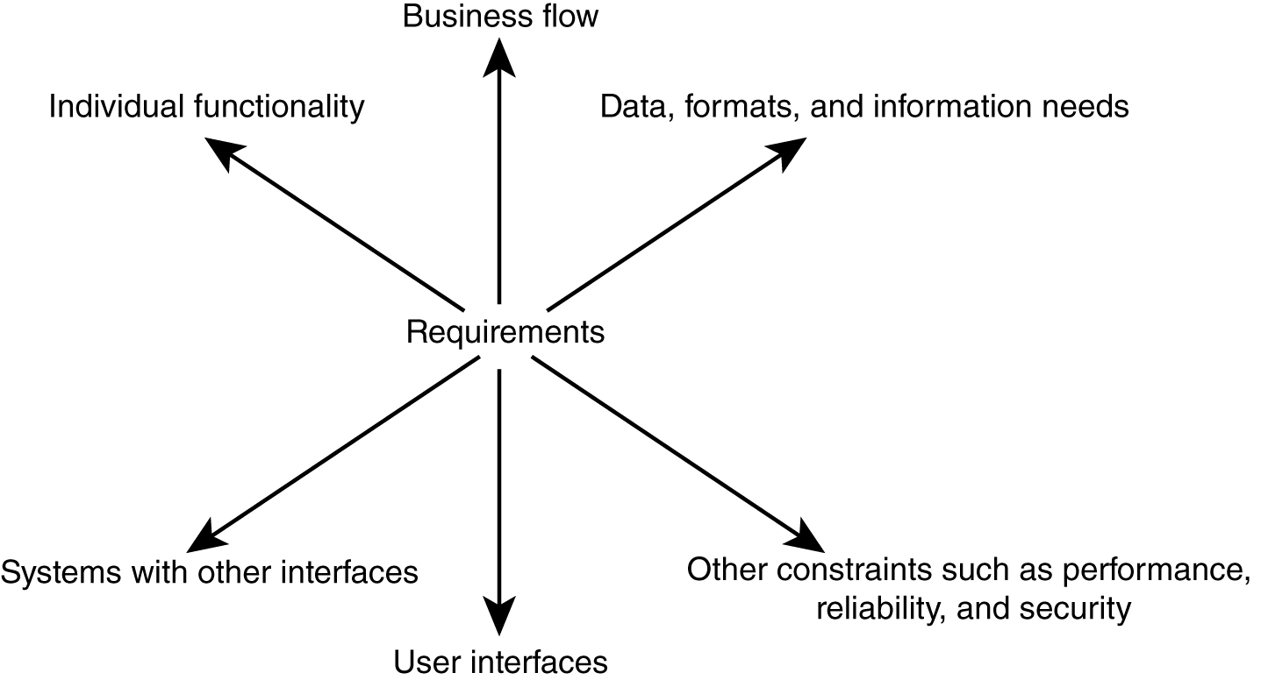
6 Dimensions of Detailed Requirements Elicitation

Slide 106
Requirements Analysis
Requirements “analysis” is composed of:
Categorizing the requirements (by some criteria)
Prioritizing the requirements
Also “start to look” for consistency and completeness (see VORD Slide)

Slide 107
Requirements Classification/Categorization
Most high level:
Functional
Non-functional
Other more detailed grouping also exists.
Six dimensions of requirements

Slide 108
Requirements Categorization
By detailed six requirements areas:
Individual functionality
Business flow (usage “scenarios”)
Data and information needs
User interfaces
Other interfaces to external systems/platforms
Various constraints (non-functional)
Performance
Security
Reliability
Etc.

Slide 109
Requirements “Analysis/Categorization” of Multiple Views
View-oriented requirements definition (VORD) is based on the concept that requirements are viewed differently by different people.
Identify stakeholders and their viewpoints of the requirements.
Categorize the viewpoints of requirements and eliminate any duplication (look for consistency and completeness).
Refine the identified viewpoints of requirements.
Map the viewpoints of requirements to the system and the services that the system must provide.

Slide 110
Requirements Prioritization
Most of the time we have some limitations in developing software:
Time
Resources
Technical capabilities (existing)
We need to prioritize the requirements to satisfy these limitations.

Slide 111
Requirements Priorities
Some criteria for prioritization:
Current user/customer demands or needs
Competition and current market condition
Anticipated future and new customer needs
Sales advantages
Existing critical problems in current product
These are often subjective and requirements should be prioritized with the help of many of the stakeholders (different viewpoints).

Slide 112
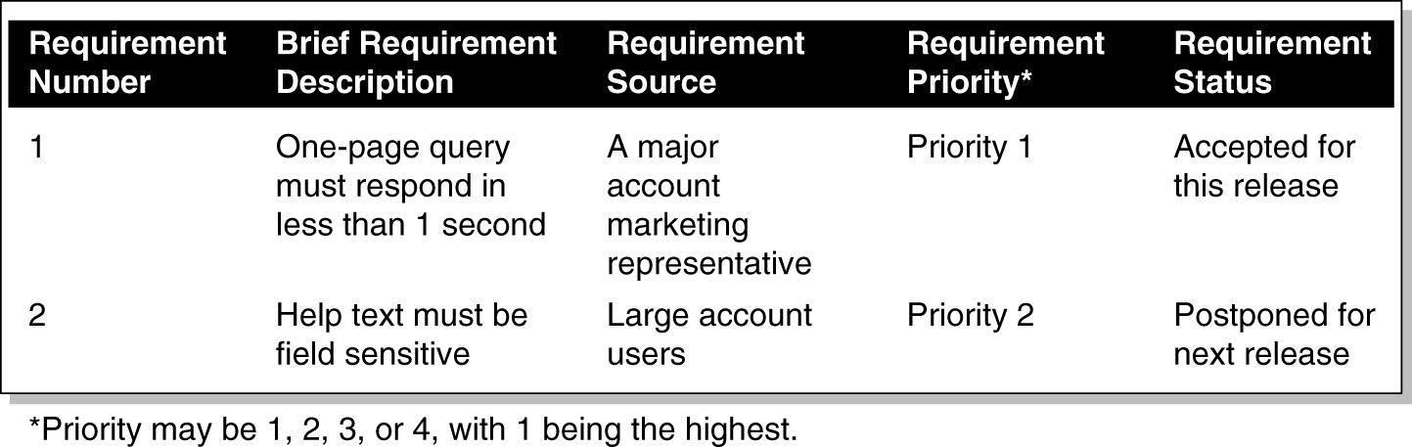
A Simple Requirements Prioritization List “Sample”
* Priority may be 1, 2, 3, or 4, with 1 being the highest.

Slide 113
Requirements Comparison and Prioritization
Requirements prioritization is an activity of comparing requirements and placing them in some order relative to each other.
Is it always performed with just experience and gut feel?
and/or
Done with a little more rigor?
Sort by priority groups (e.g., previous 2 charts) where the priority groups are based on some prioritization criteria list (e.g., current user needs has the highest priority).
Pair-wise comparison: normalize and compute relative value using the Analytical Hierarchical Process (AHP) – see pages 159–161 of textbook (you are responsible for reading this).

Slide 114
Analytical Hierarchical Process (AHP) Example
 | Req 1 | Req 2 | Req 3
Req 1 | 1 | 2 | 3
Req 2 | 1/2 | 1 | 2
Req 3 | 1/3 | 1/2 | 1
Requirements Prioritization
Req 1 = 1.62 / 3 = 54%
Req 2 = .89 / 3 = 30%
Req 3 = .49 / 3 = 16%
1.83
3.5
6.0
 | Req 1 | Req 2 | Req 3
Req 1 | .55 | .57 | .5
Req 2 | .27 | .29 | .33
Req 3 | .18 | .14 | .17
1.62
.89
.49

Slide 115
Requirements Definition/Prototyping/Review
Once the requirements are solicited, analyzed, and prioritized, more details may/must be spelled out. Three major activities that may be intertwined must be performed:
Requirements definition
Requirements prototyping
Requirements reviewing

Slide 116
Requirements Definitions/Documentation
Requirements definitions may be written in different forms:
Simple input/process/output (I-P-U) descriptions in English
Dataflow diagrams (DFD)
Entity relations diagram (ERD)
Use case diagram from Unified Modeling Language (UML)
Once the requirements are defined in detail using any of the above forms, they still need to be reviewed (see Chapter 10 of your textbook) by the users/customers and other stakeholders.
Formal
review
by others

Slide 117
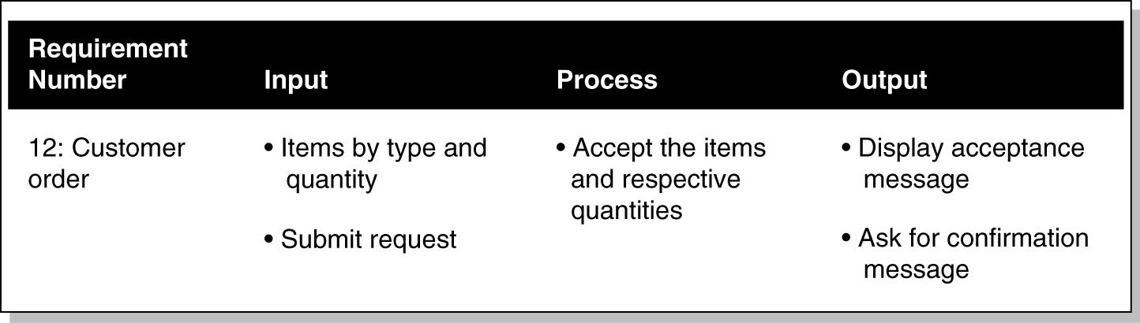
Requirements Definition Using English and Input-Process-Output Diagram Form
English I-P-O: functionality, business, and data flow

Slide 118
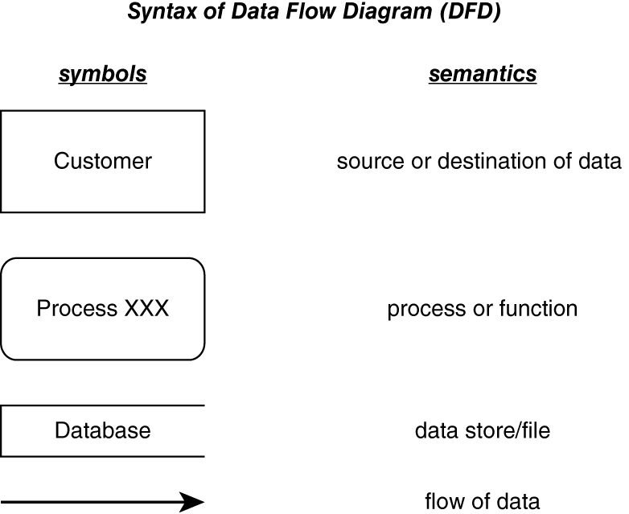
Syntax of Data Flow Diagram (DFD)

Slide 119
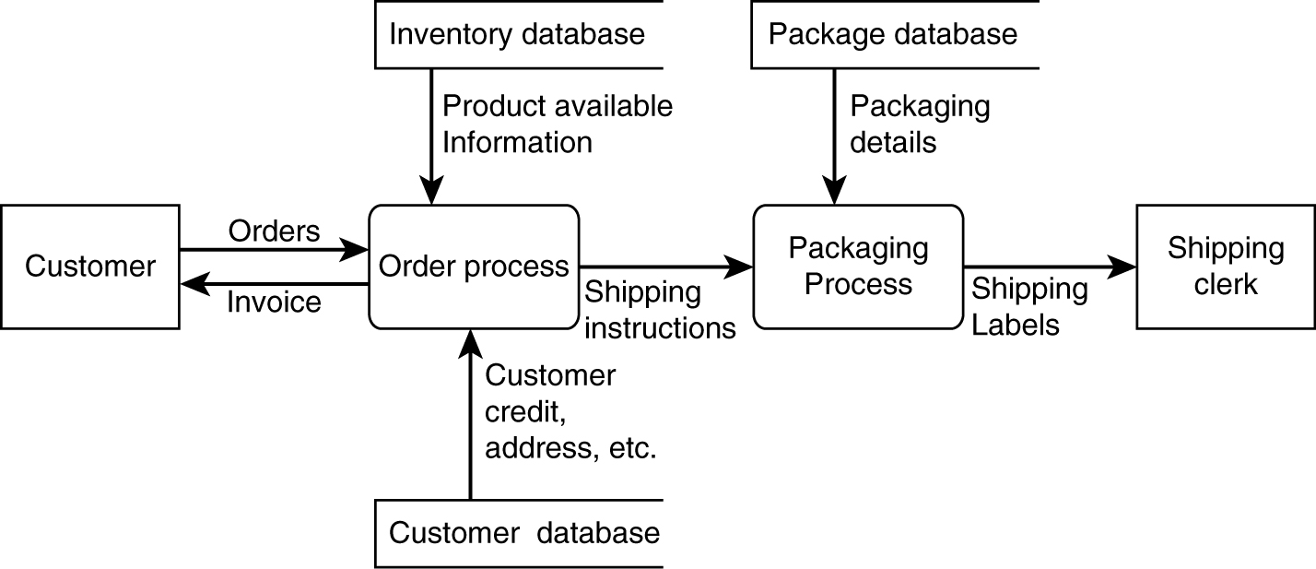
Requirements Definition Using DFD
Captures functionality, business flow, data.
Notes:
4

Slide 120
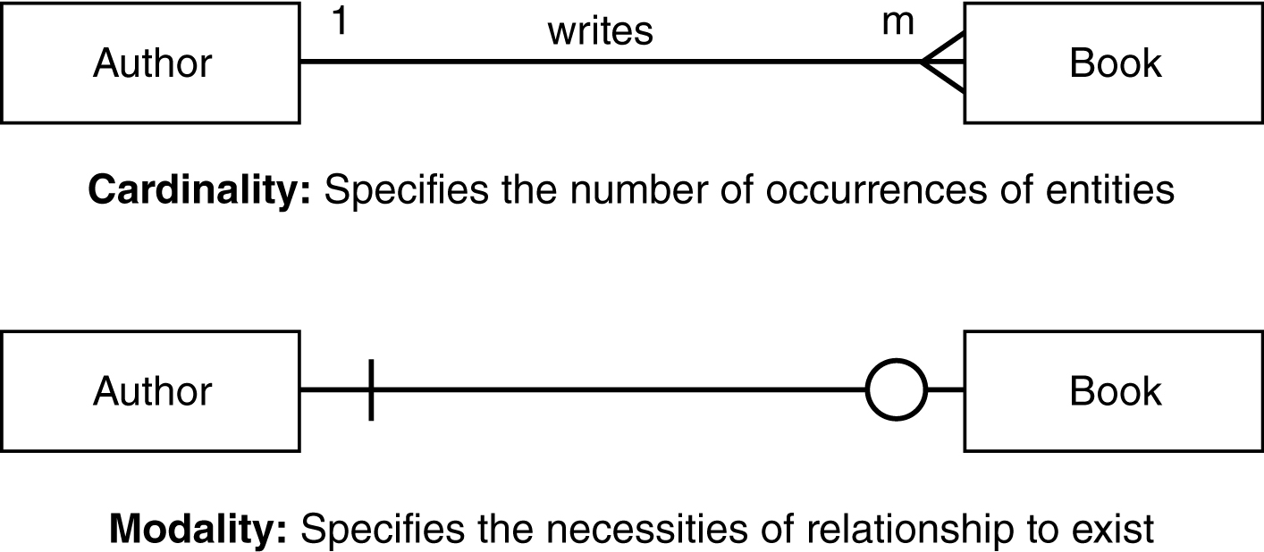
Requirements Definition Using Entity Relation Diagram (ERD)
Captures relations among data.

Slide 121
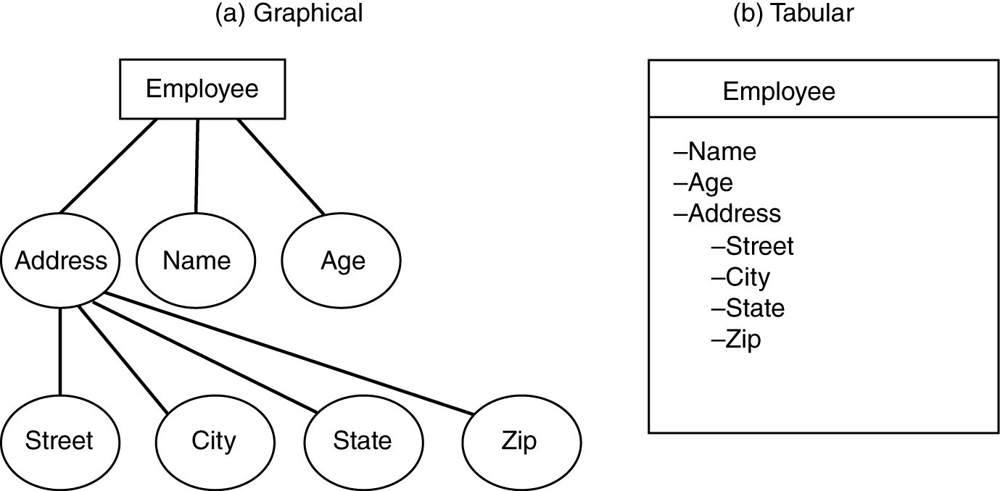
Requirements Definition Specifying Entity and Attributes
Captures relations among data.

Slide 122
Requirements Analysis & Definition Methodology Using UML
Using OO Use Case Methodology and Notation, which identifies:
Basic/main functionalities
Pre-conditions of functionality
Flow of events or scenarios
Post-conditions for the functionality
Error conditions and alternative flows
Using OO Use Case Diagram, which identifies:
Actors (or all external interfaces with the system, including the users)
Related “use cases” (major functionalities)
Boundary conditions
Use cases may be further refined during design.

Slide 123
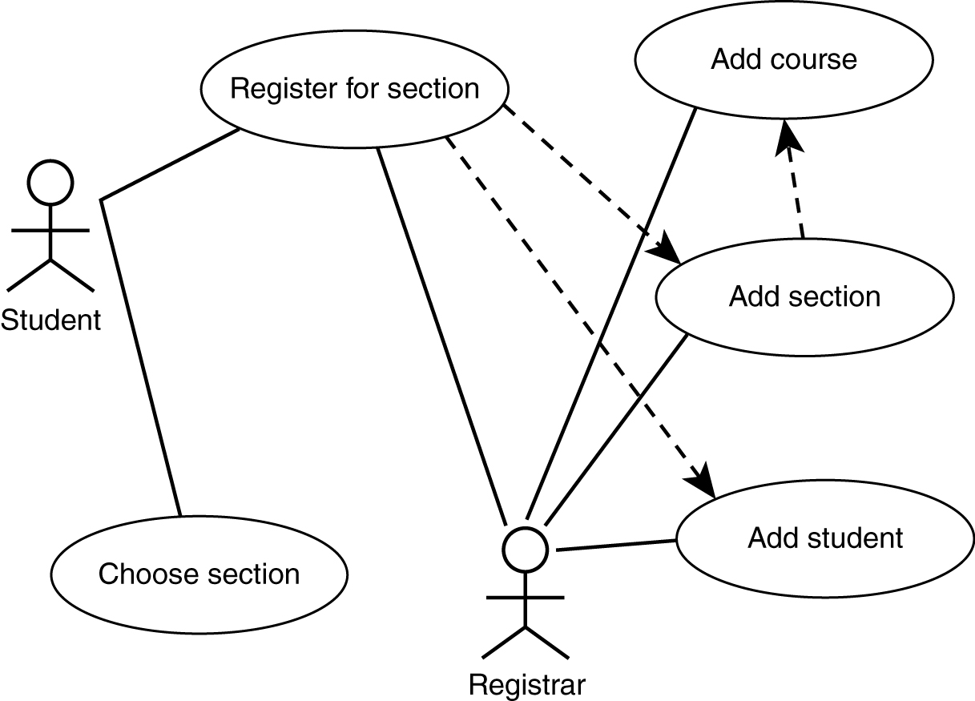
Requirements Definition Using Use Case Diagram (for major functionalities)

Slide 124
Requirements Definition Using Use Case Description
Use case diagrams are mostly for functionalities and are not detailed enough—so we need to use “English” text for further descriptions of the requirements:
Functional details
Pre-conditions
Post-conditions
Non-functional characteristics about the functionalities
“Alternative paths” (e.g., error processing)
UI sample (e.g., “looks”)
Etc.

Slide 125
Requirements Traceability
Capability to trace a requirement is needed to ensure that the product has fully implemented the requirements (while not part of requirements process activities – it needs to be started early).
We need to trace requirements:
Requirements from source (people and documents)
Requirements to later steps (design, implementation, test, and release)
We also need to link requirements to other “prerequisite” requirements.

Slide 126
Partially Filled Traceability Table
Requirement | Design | Code | Test | Other Related Requirements
1 | compon. X | Module 3 | Test Case 32 | 2, 3
2 | compon. w | Module 5 | Test Case 16 | 1
3 | compon. X | Module 2 | Test Case 27 | 1
4
5
6
7

Slide 127
Requirements Prototyping
Requirements prototyping mostly addresses the user interface (UI) part of the requirement in terms of:
Visual looks (size, shape, position, color)
Flow (control and logical flow; depth of flow)
The prototyping may be performed in one of the two modes:
Low fidelity: using paper/cardboard to represent screens and human to move the boards
High fidelity: using automated tools such as Visual Basic to code the screens and direct the logical flow of these screens

Slide 128
Requirements Specification
Once the requirements are defined, prototyped, and reviewed, they must be placed into a Requirements Specification document.
IEEE /EIA Standard 12207.1-1997 may be purchased from IEEE. It outlines the guideline for three major sections of a requirements specification document.
Introduction
High-level description
Detailed descriptions
Details of each functionality (input-output-process)
Interfaces, including user interfaces and network interfaces
Performance requirements (response time, throughput, etc.)
Design constraints, standards, etc.
Additional attributes such as security, reliability, etc.
Any additional unique requirements

Slide 129
Finally — Requirements “Sign-Off”
Having a requirements specification agreed to and signed off on is important.
Serves as a milestone marker and formally exits a phase of software engineering.
Serves as baseline from which any future changes can be monitored and controlled.
Remember “agile”—which wants less “legalese” like sign-off
—obviously, I disagree when it comes to large/expensive projects!

Slide 130
Chapter 7: Design: Architecture and Methodology

Slide 131
Design Topics Covered
Architectural vs. detailed design
“Common” architectural styles, tactics, and reference architectures
Basic techniques for detailed design
Basic issues with user-interface design

Slide 132
Design
Starts mostly from/with requirements (evolving mostly from functionalities and other non-functional characteristics).
How is the software solution going to be structured?
What are the main components—(functional comp)?
Often directly from requirements’ functionalities (use cases).
How are these components related?
Possibly re-organize the components (composition/decomposition).
Two main levels of design:
Architectural (high level)
Detailed design
How should we depict design—notation/language?

Slide 133
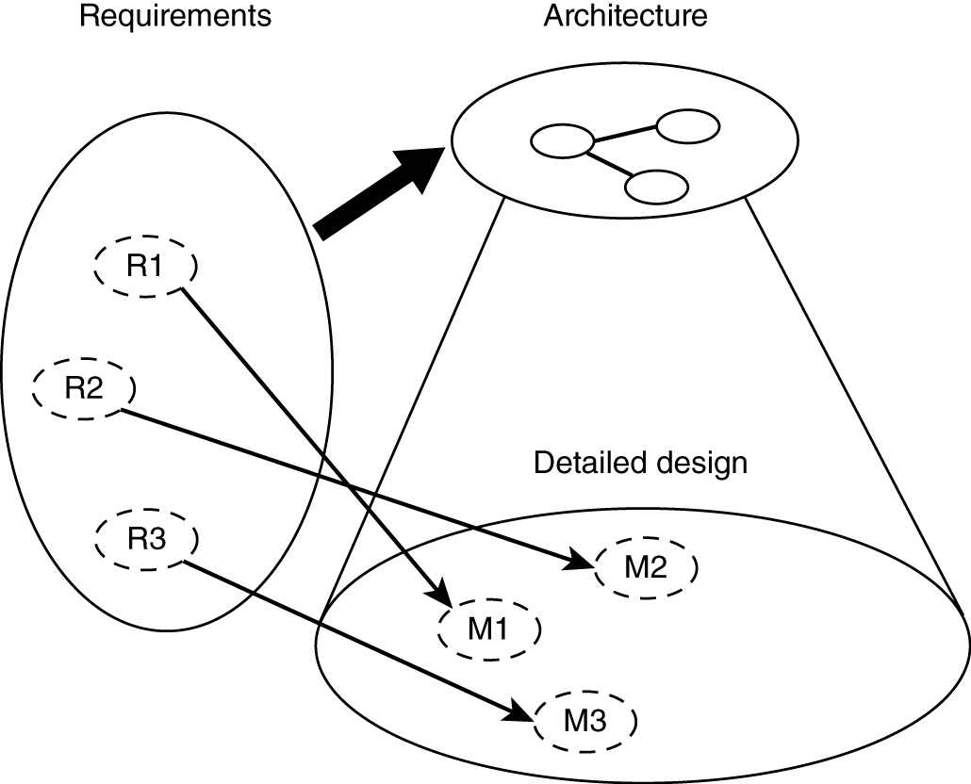
Relationship between Architecture and Design
Detailed Design
Comes from
Requirements &
Architecture

Slide 134
Software Architecture
Structure(s) of the solution, comprising:
Major software elements
Their externally visible properties
Relationships among elements
Every software system has an architecture.
May have multiple structures!
Multiple ways of organizing elements, depending on the perspective
External properties of components (and modules)
Component (module) interfaces
Component (module) interactions, rather than internals of components and modules

Slide 135
Views and Viewpoints
View – representation of a system structure
4+1 views (by Krutchen)
Logical (OO decomposition – key abstractions)
Process (run-time, concurrency/distribution of functions)
Subsystem decomposition
Physical architecture
+1: use cases
Other classification (Bass, Clements, Kazman)
Module
Run-time
Allocation (mapping to development environment)
Different views for different people

Slide 136
Architectural Styles/Patterns
We discuss architectural styles/patterns as
“reusable” starting point for design activities.
Pipes and filters
Event driven
Client-server
Model-view-controller (MVC)
Layered
Database centric
Three tier

Slide 137
Pipe-Filter Architecture Style
The high-level design solution is decomposed into two “generic” parts (filters and pipes):
Filter is a service that transforms a stream of input data into a stream of output data.
Pipe is a mechanism or conduit through which the data flows from one filter to another.
Input
time cards
Prepare for
check processing
Process checks
** Reminds one of DFD without the data store or source sink.**
Problems that require batch file processing seem to fit this architecture: e.g., payroll, compilers, month-end accounting.

Slide 138
Event Driven (Real Time)
The high-level design solution is based on an event dispatcher, which manages events and the functionalities that depend on those events. These have the following characteristics:
Events may be a simple notification or may include associated data.
Events may be prioritized or be based on constraints such as time.
Events may require synchronous or asynchronous processing.
Events may be “registered” or “unregistered” by components.
voice
call
Phone
processing
text
msg
Personal (device)
dispatcher
Text
processing
Image
keypad
Image
processing
Problems that fit this architecture include real-time systems such as: airplane control,
medical equipment monitor, home monitor, embedded device controller, game, etc.
- - - Try a commercial flight control system - - -

Slide 139
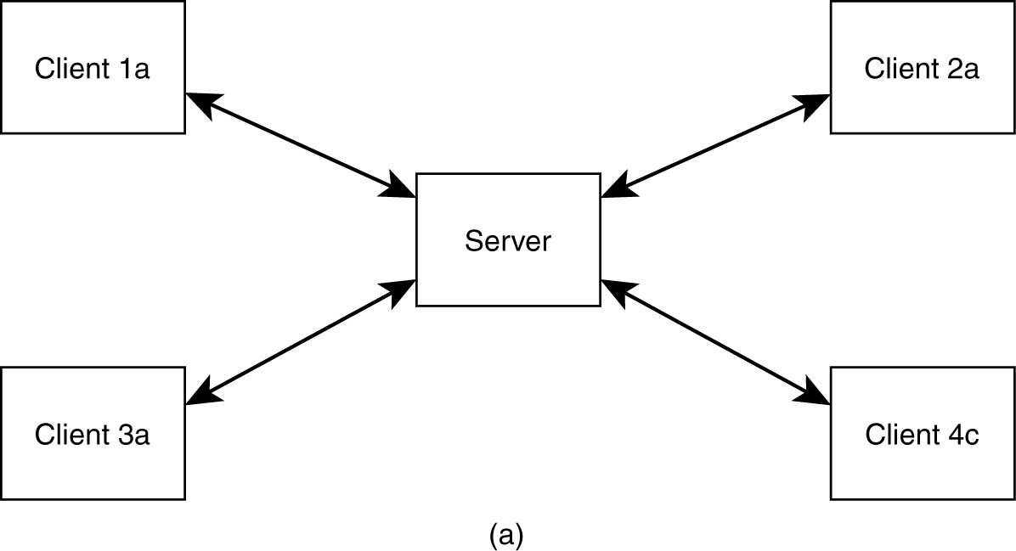
Basic Client-Server Style
Application split into client component and server component.

Slide 140
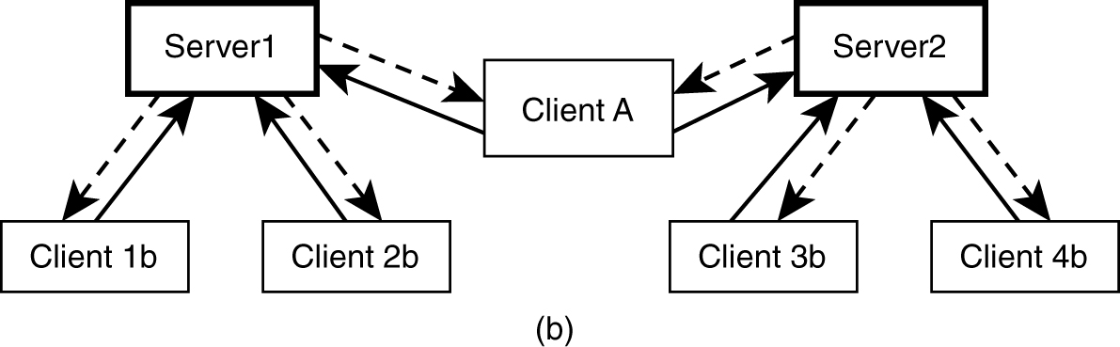
Client-Server Style
Client may connect to more than one server (servers are usually independent).

Slide 141
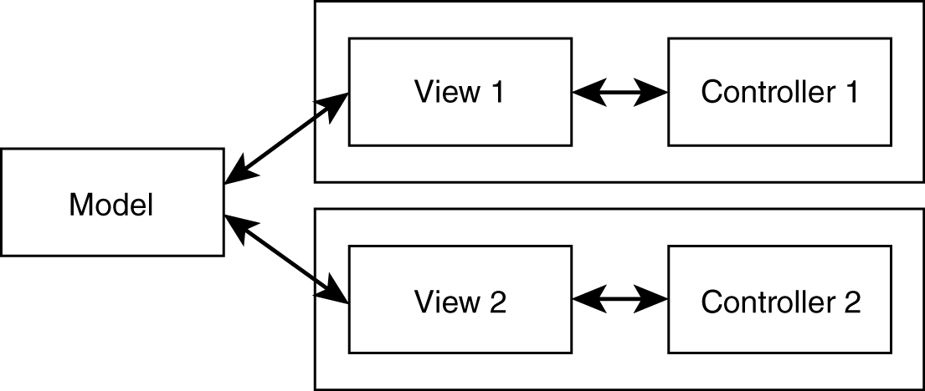
Model-View-Control (MVC) Style
Separates model (data) from view.
Controller often integrated with view nowadays.
Most internet web applications fall under this style.

Slide 142
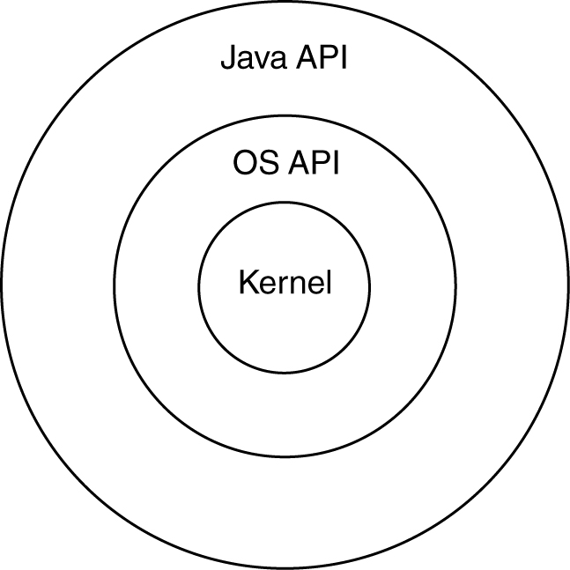
Layered Style
The “outer” layer can only ask for service from the “inner” layer; the “upper” layer can only ask for service from the “lower” layer.
− Strict layering: only directly inside or below layers
− Relaxed layering: any inside or below layers

Slide 143
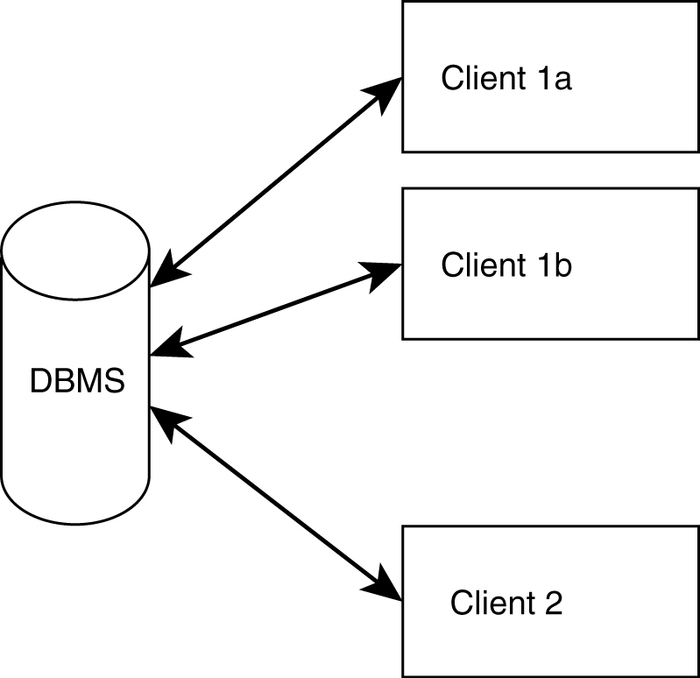
Shared Data (DB)-Centric Style
Very popular within the business applications community

Slide 144
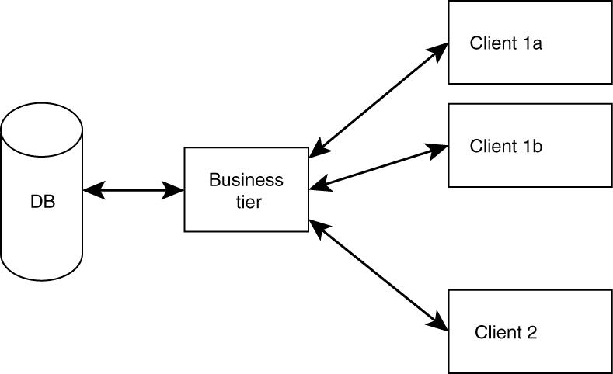
Three-Tier Style (Mixture)
Clients do not access DB directly.
Better flexibility, integrity. (Why?)
Reminds one of client server or MVC.

Slide 145
Architectural Tactics
Tactics (in contrast to architectural style) are for solving “smaller, specific” problems.
Do not affect overall structure of system.
Example: we add specific functionalities or component (e.g., to increase reliability) in the design for fault detection—especially for distributed systems:
Heartbeat
Ping/echo

Slide 146
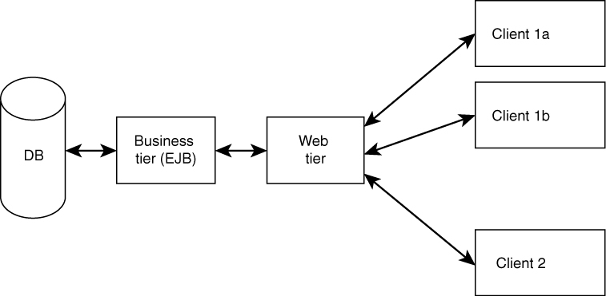
Reference Architectures
Full-fledged architectures.
Serve as “templates” or as “a reference” for a class of systems.
Example: J2EE reference architecture (MVC2).
There also are “application domain−specific” reference architectures.

Slide 147
Detailed Design
Further refine architecture and match with requirements.
How detailed?
How formal?
Maybe of different levels of detail for different views.

Slide 148
Functional Decomposition Technique
Dates back to “structured programming” [now (non-OO) Web apps with PHP tool].
Start with: main (task/requirements) --> module.
Refine into sub-modules.
There are alternative decompositions.

Slide 149
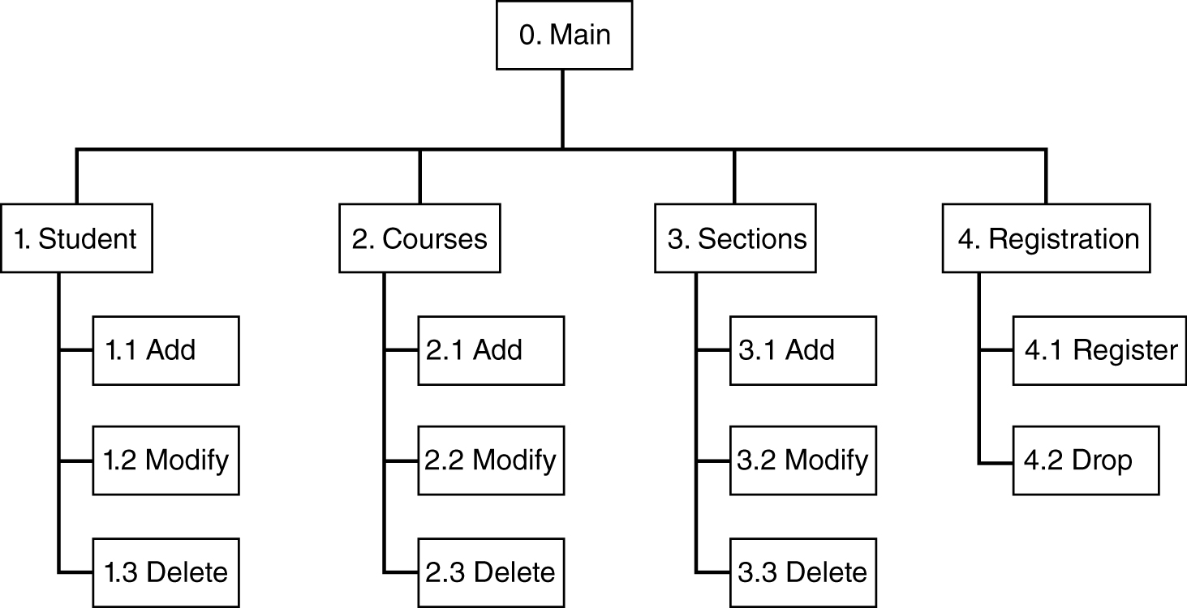
Possible Decomposition of (Student-Course Management App)

Slide 150
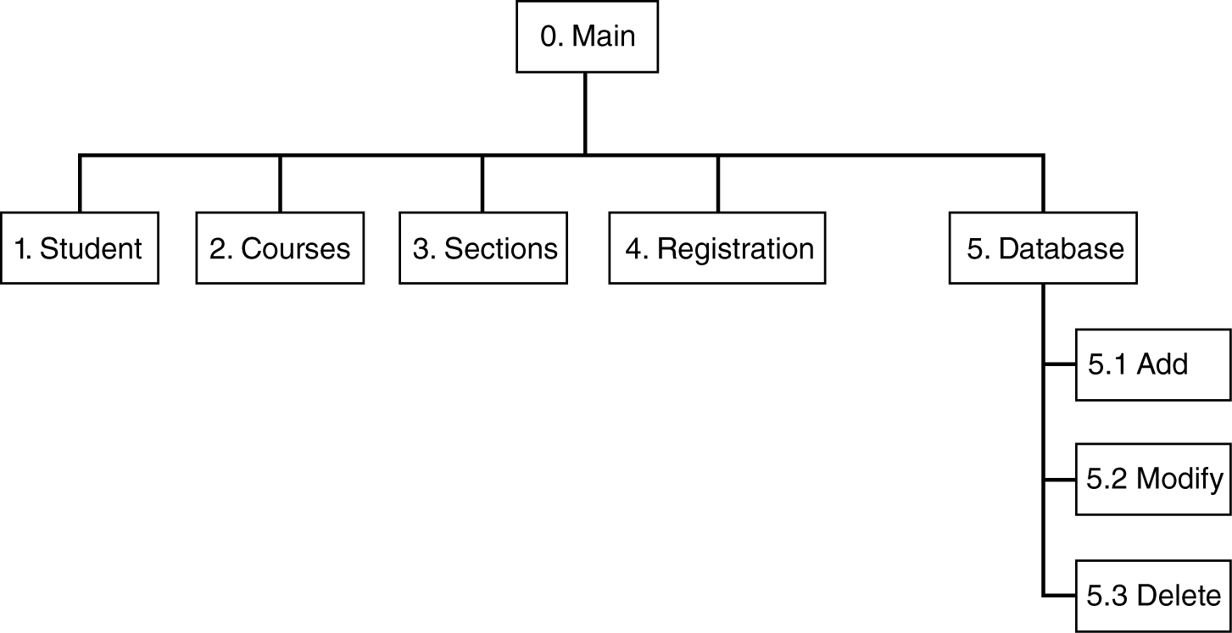
“Alternative” Decomposition/Composition

Slide 151
Relational Database Design
Most databases use relational technology.
Relations (tables):
Two-dimensional sets
Rows (tuples), columns (attributes)
A row may be an entity; columns may be relationships or attributes.
Primary key (unique identifier) – for search
Foreign keys (connects tables)

Slide 152
Database Design
Conceptual modeling (done during analysis/requirement phase) produces ER diagram.
Logical design (to relational).
Physical design (decide data types, etc.).
Deployment/maintenance:
Low-level physical (which hard drive, etc.)
Adjustment of indexes

Slide 153
Entity-Relationship Diagrams
Entities (rectangles)
Weak: double lines
Relationships (diamonds)
Attributes (ovals)
Multi-valued: double lines
Identifying: underlined

Slide 154
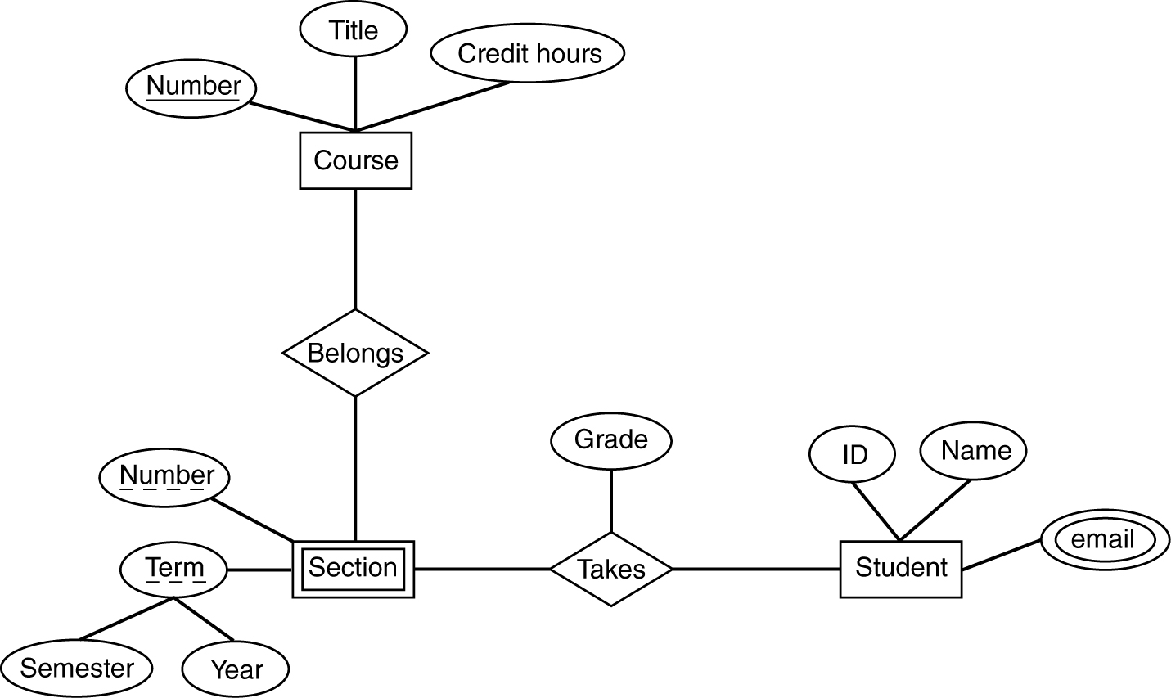
ER Diagram Example

Slide 155
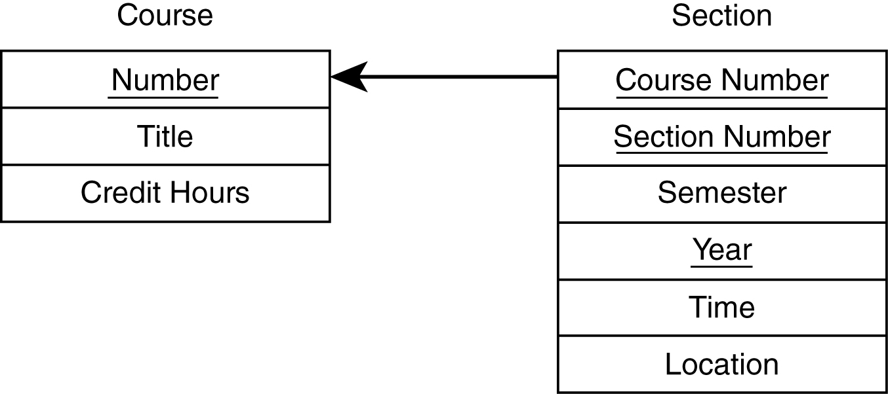
Logical DB Design – Entities
Table per entity.
Flatten composite attributes.
For weak entities, add the primary key of the strong entity.

Slide 156
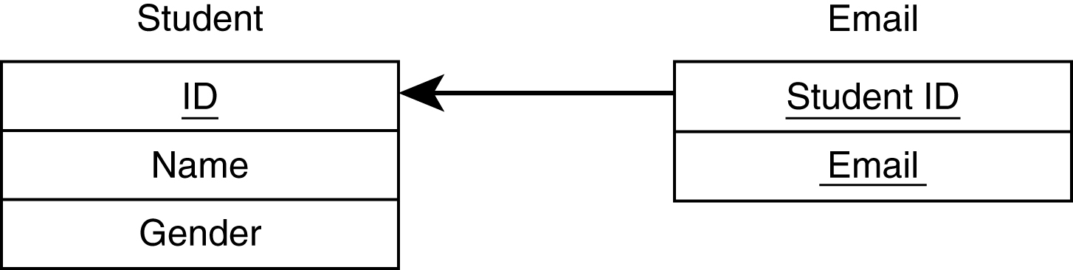
Logical DB Design – Multi-Valued
New table needed for multi-valued attributes.

Slide 157
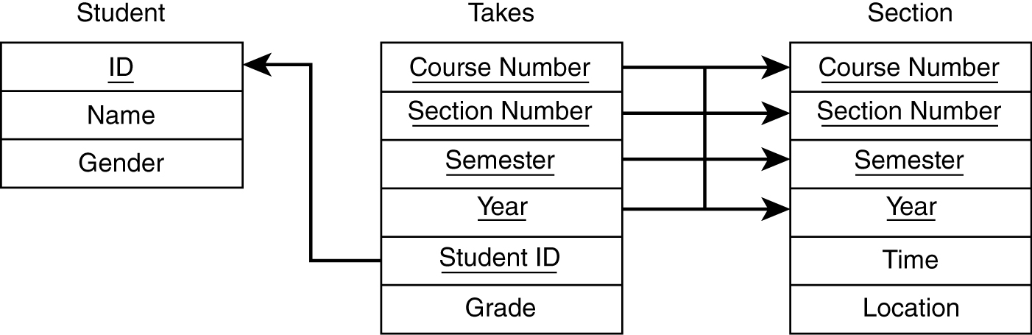
Logical DB Design – Relationships
If one side related to just one entity, add foreign key to that side.
For many to many, need new table.
For ternary, need new table.

Slide 158
Physical DB Design
Data types for each attribute.
Check which ones your DBMS support.
Encoding.
Decide on indexes.
Searches are faster, updates are slower.
Indexes consume space.
Can always adjust during deployment.
Denormalization done sometimes (avoid).

Slide 159
OO Design
First step: review and refine use cases.
Decide:
Which classes to create
How are the classes related
Use UML as the design language.

Slide 160

Use Case Diagram

Slide 161
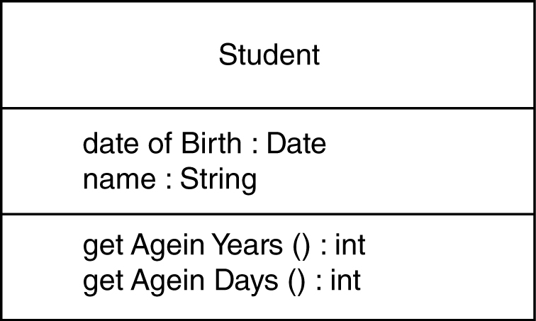
Class Design
Classes represent real-world entities or system concepts.
Organized into classes: objects in a class have similar characteristics.
Classes have properties (attributes or data).
Classes also have methods (perform functions).

Slide 162
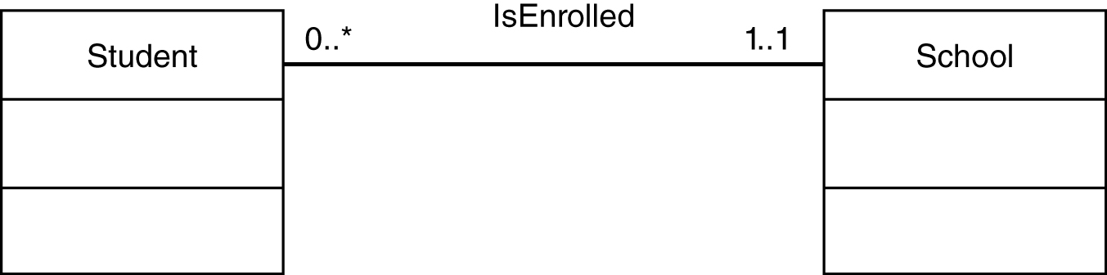

UML Class Diagrams
Association
Composition
Use “no-fill” diamond for aggregation.

Slide 163

UML Class Diagrams – Inheritance

Slide 164

UML State Diagram
depicting a student’s “status” in school

Slide 165

UML “Sequence Diagram”
used to depict a flow of interactions

Slide 166

User Interface Design
Most apparent to the user
Two main issues:
Flow of interactions
ii) Look and feel
Types of interfaces
Command-line
Text menus
Graphical (GUI)

Slide 167

Flow of Interactions
Prototype screens
Registration:
Select term.
Registration: shows term.
Select first course.
Registration: shows term, course(s) with schedule and cost.
Select *Additional course; *Delete course; *Finish registration.
Registration: shows final schedule.
Select Confirm or Cancel.

Slide 168



High Fidelity Prototype

Slide 169

User: Screens: Process:

Slide 170

User Interaction Added to the Sequence Diagram

Slide 171

Norman’s 7 Stage Model

Slide 172
The GOMS Model (an “advanced” topic for UI)
Consider different kinds of users.
Four factors (for the kind of user)
Goals of the user
Operations provided by the system
Methods or the sequence of operations
Selection rules for the methods

Slide 173
Other UI Issues
Kinds of users
Heuristics
UI guidelines
Multicultural issues
Metaphors
Multiplatform software
Accessibility
Multimedia interfaces

Slide 174

HTML Script Simple Example

Slide 175
Model-View-Controller (MVC) Software Project
View HTML
Controller PHP
Model
SQL database

Slide 176

Object-Relational Impedance Mismatch (an “advanced” topic)
How do we handle mismatches between object-oriented concepts and relational DB such as:
Typing
Private and public
Inheritance and polymorphism
Nested structure versus table structure

